Slide 1
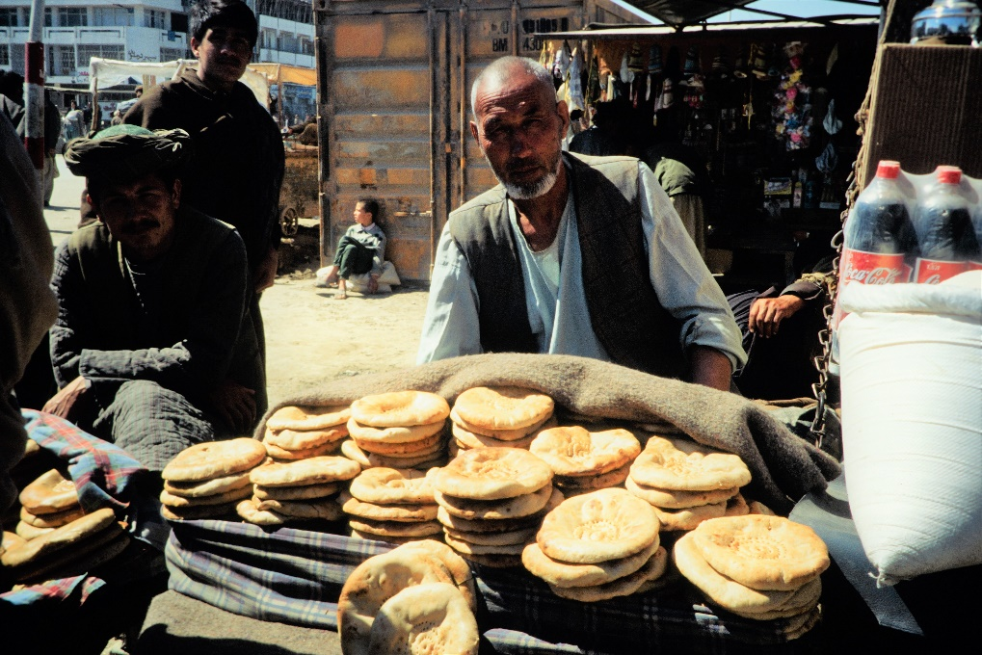
Jesus - bread of life
Mark 6: 30-44

Slide 2
1. Don‘t underestimate Jesus‘ concern for you: Get some rest (Mark 6: 30-33)
…because so many people were coming and going that they did not even have a chance to eat,
Jesus said to them: Come with me by yourselves to a quiet place and get some rest. (v31)

Slide 5
2. Don‘t underestimate what Jesus can do with your limited resources: Give the little you have got to Jesus (Mark 6: 34-38)
When Jesus landed and saw a large crowd, he had compassion on them, because they were like sheep without a shepherd. So he began teaching them many things. v34
(Jesus to his disciples): You give them something to eat! v37
Jesus … had already in mind what he was going to do (John 6:6)

Slide 7
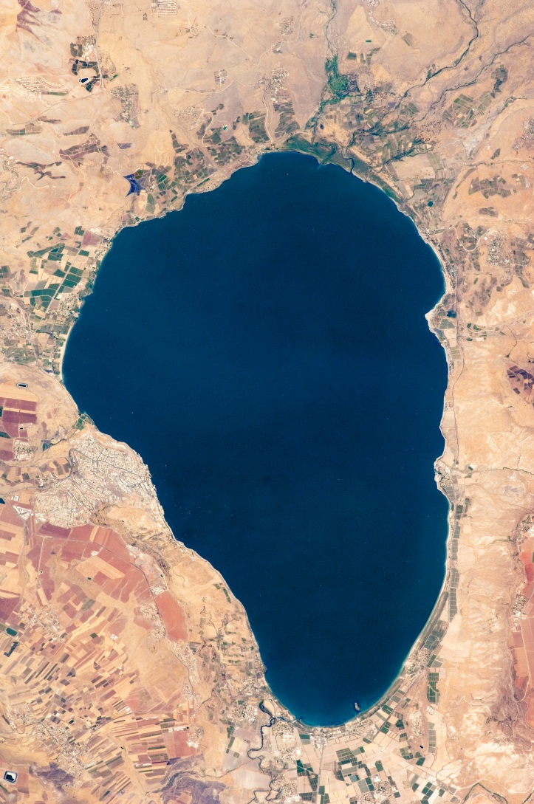
2. Don‘t underestimate Jesus‘ knowledge what people really need: Get involved (Mark 6: 39-44)
They all ate and were satisfied. (v42)
5000
4000
By Rob - Derived from:United Kingdom on the globe (United Kingdom centered).svg, CC BY-SA 3.0, https://commons.wikimedia.org/w/index.php?curid=31431456

Slide 9
Do not work for food that spoils, but for food that endures to eternal life, which the Son of Man (= Jesus) will give you
(John 6: 27)

Slide 10
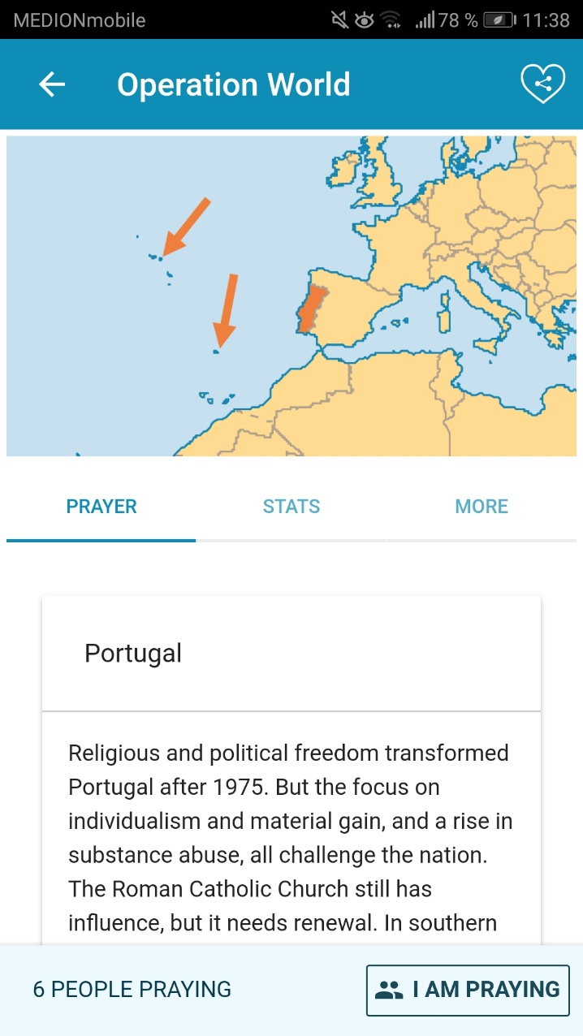
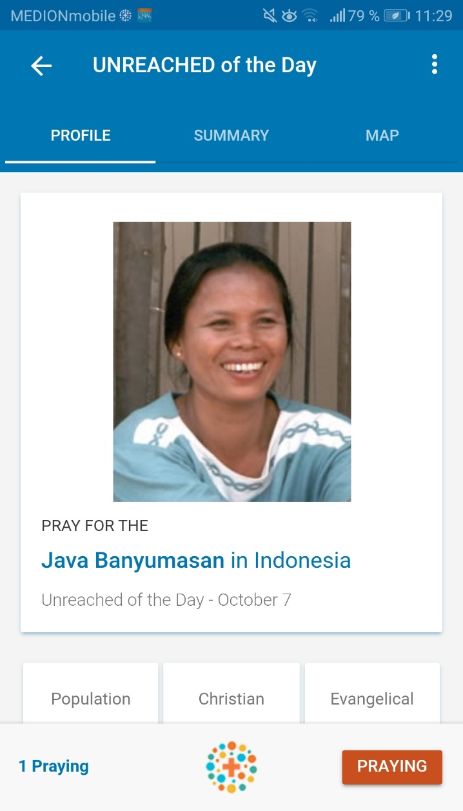
joshua project app
operation world app

Slide 11
Jesus - bread of life who satisfies
Mark 6: 30-44

Slide 12
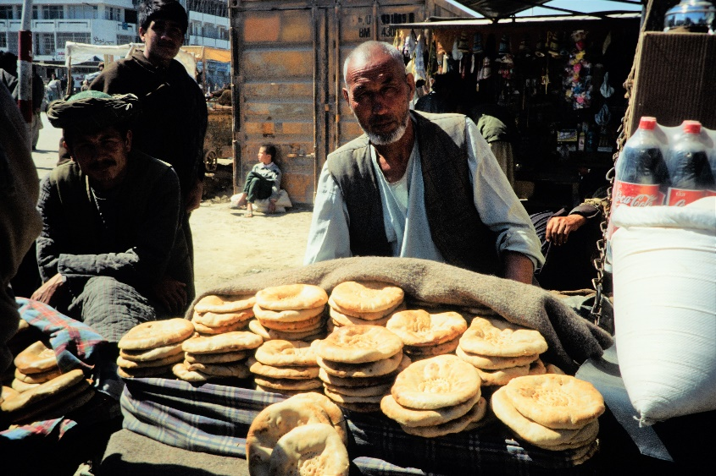
Jesus says:
I am the bread of life. Whoever comes to me will never go hungry, and whoever believes in me will never be thirsty.
…. whoever comes to me I will never drive away.
(John 6: 35-37)

