Slide 1
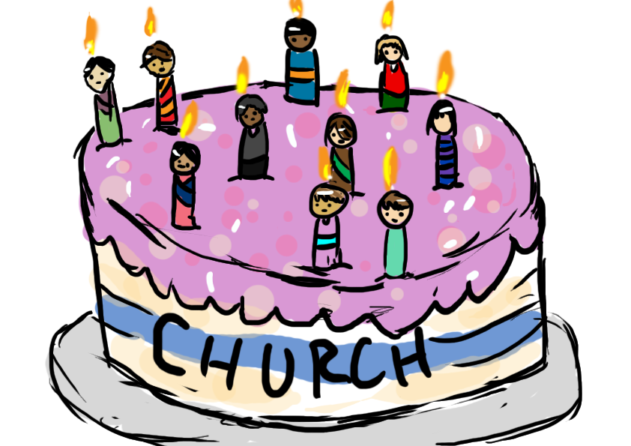
The Church that Changes the World
The Pentecostal Church
Acts 2.1-13
Notes:
At least in some sense, this is the birthday of the church. Yes, the OT sees God gathering a people and, yes, Jesus calls many people to follow him.
But here is something new. The Spirit poured out on all the believers and a new chapter in God’s dealings with people beginning.
This is our birthday text.
We think of this from an individual standpoint. God wants to work in us as individuals. But God wants to do something corporately too, in this gathering. All together, the whole room was filled, tongues of fire on each of them, they were all filled. It’s unmistakable. Luke makes the point no one was missed out.

Slide 2
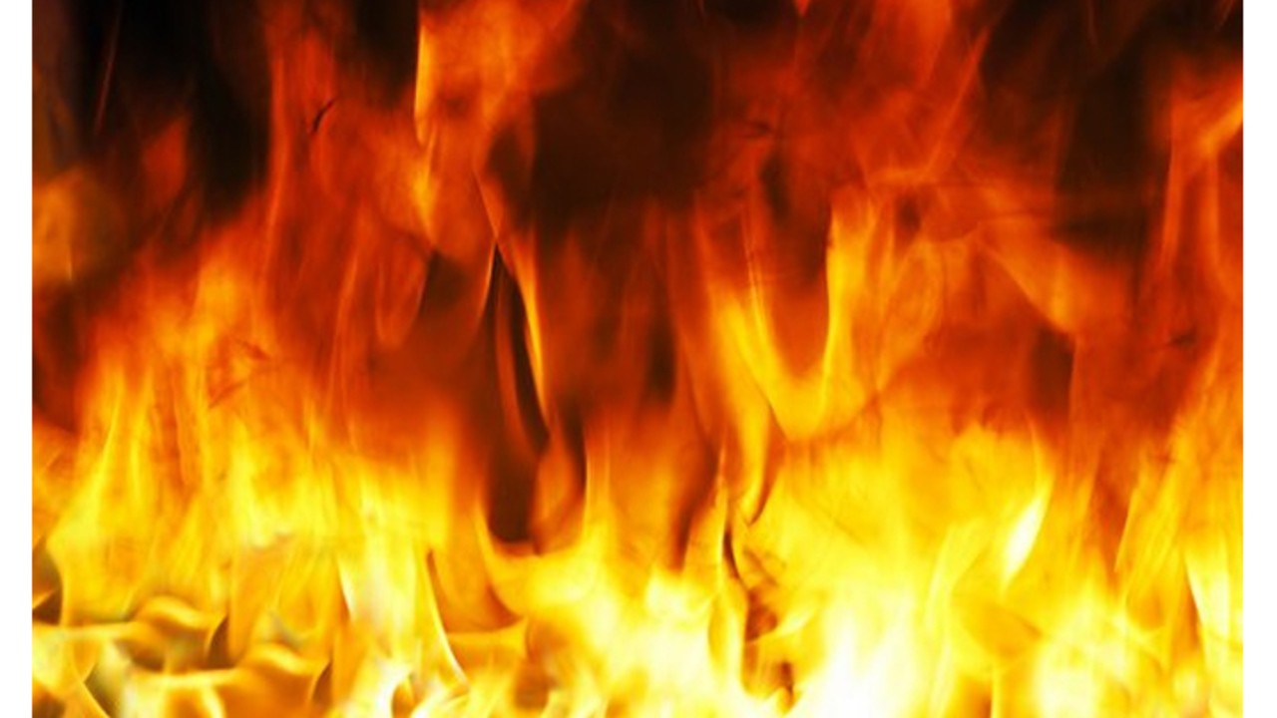
Catch a sense of the excitement
Sound like a violent wind (v2)
What seemed to be tongues of fire (v3)
The crowd comes together, the tongues are spoken, there is bewilderment, are they drunk? (vv4-13)
Notes:
We can analyse like dissecting an animal. We understand it but there’s not a lot of life.
Sound like…
Before we plunge in, we should get a sense of the whole.
Seemed to be…
The limits of human language are being strained.
It sounded like a mighty wind, it wasn’t, but that’s as close as we can get. It seemed like tongues of fire; it wasn’t that, it was more than that, but, we’re struggling to describe it.
The crowd come, the tongues spoken are misunderstood.
Is it too much wine?

Slide 3
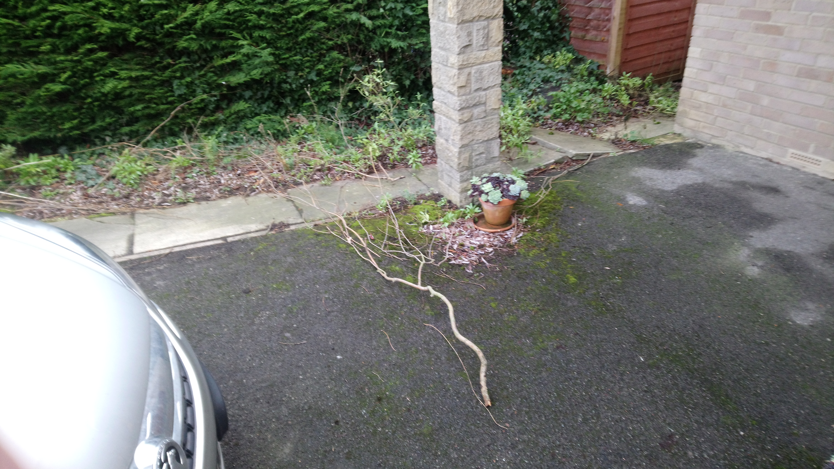
Notes:
The wind is powerful.
Storm Erik.
Photo of my garden. Actually looked the same before the storm!
Buffeting the car on the way to Mirfield.

Slide 4
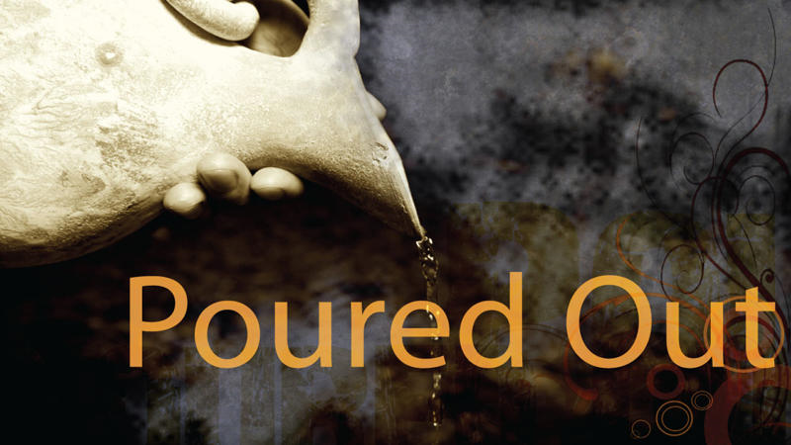
What is happening here?
God is pouring out his Spirit on his people.
All. Cf. Psalm 51
And there are many more who will receive the Spirit.
Notes:
The Spirit was given to particular people for particular occasions.
The Spirit could be withdrawn. Saul experienced that. David fears that.
Luke lists 5 groupings, moving broadly speaking from east to west. There are descendants of Shem, Ham and Japheth, the three Sons of Noah. Representatives of all the nations.
The disciples in Acts 1 to go into all the world. Now representatives of all the world are hearing.
This is a reversal of Babel. Genesis 11. There in their arrogance they built up. God came down and scattered. Now God comes down and gathers.
God is gathering people all over the world. It includes us and he wants to use us to gather more.

Slide 5
Speaking in ‘Tongues’
No need for division
God touches our lives in different ways, but the same Spirit
Notes:
Mirfield St Hild. Deep division in a church. We were able to talk that through.
Division often comes when a particular experience is pressed on us as the norm for all.
Moment of consecration and no tongues, consecration and tongues, in quiet ways and in noisy ways, through a steady diet of Bible and prayer and service.
God respects our temperaments.
Take the heat out of this.

Slide 6
The Speaking in ‘Tongues’
Something here that is unique
Something here that is repeatable
We receive the Spirit at conversion but are called to ‘be being filled’ with the Spirit (Ephesians 5.18)
Notes:
The Greek is glossolalia. It could be other tongues or other languages. Here certainly it is languages, supernaturally given but readily understood (v6).
There are some features here that are unique. The seeming tongues of fire, the sound like a rushing wind. These are not repeated. There is something here about the dawning of a new era.
But this is one of the signs of us being filled with the Spirit.
Broader reflection. This

Slide 7
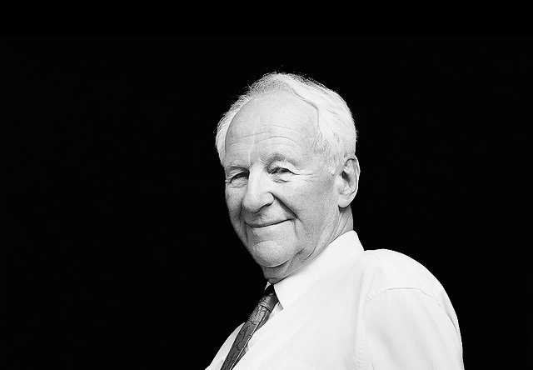
Without the Holy Spirit, Christian discipleship would be inconceivable, even impossible. There can be no life without the life-giver, no understanding without the Spirit of truth, no fellowship without the unity of the Spirit, no Christlikeness of character apart from his fruit, and no effective witness without his power. As a body without a breath is a corpse, so the church without the Spirit is dead.
John Stott
Notes:
But to be filled is absolutely essential.
Seek, pray, be open, consciously depend, receive.

Slide 8
Word, Spirit and Mission
They respond to the word, and under the influence of the Spirit they speak it out in mission.
‘Biblical renewal for mission’
Notes:
Responding to the word and speaking it out in the power of the Spirit in mission.
Charismatic renewal in the 1960s. May need to describe. Became sugar rush Christianity. Can’t survive without the next experiential hit. That’s not what we see here.

