Slide 1
Passion for God
Love for people
Heart for mission
Preaching series
Home Group Studies
Whole Church Meeting: 22 November

Slide 2
Psalm 63 Passion for God

Slide 3
1. Appreciating the Passion
Do we have the passion for God the Psalmist had?

Slide 4
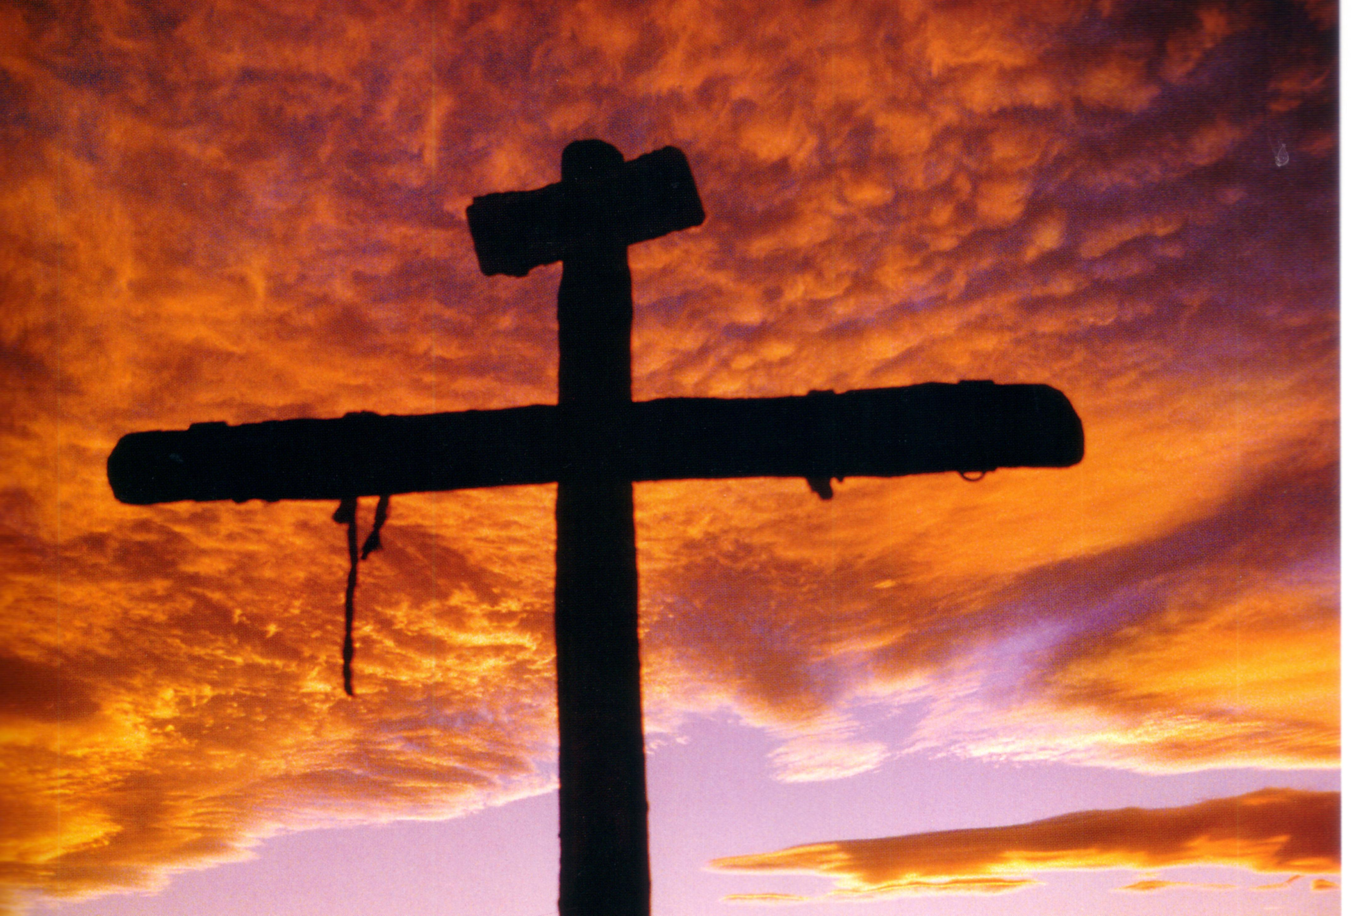
2. Growing in Passion
We can try to ‘work up’ passion,
focusing on our own feelings, or…
… we can look at v3

Slide 5
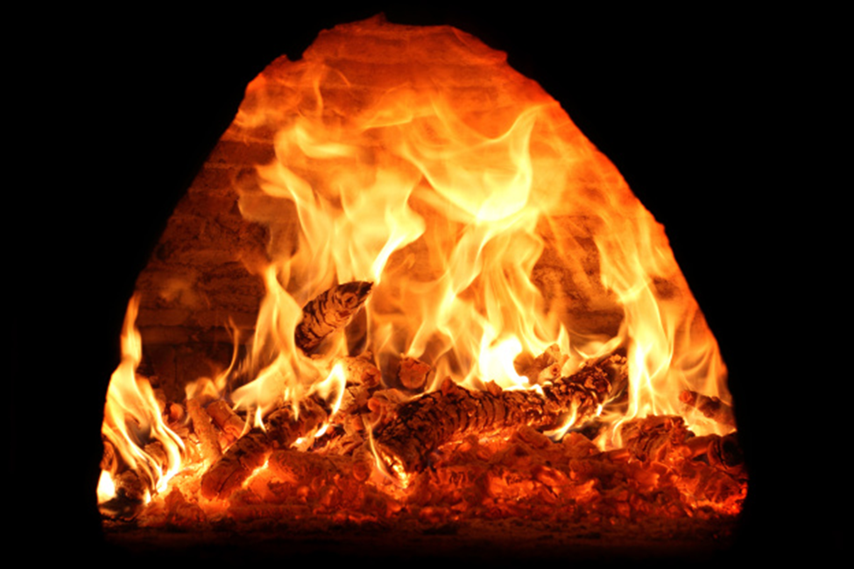
Passion for God needs fuel to burn, just as a fire does

Slide 6
3. Passion under Pressure

