Slide 1
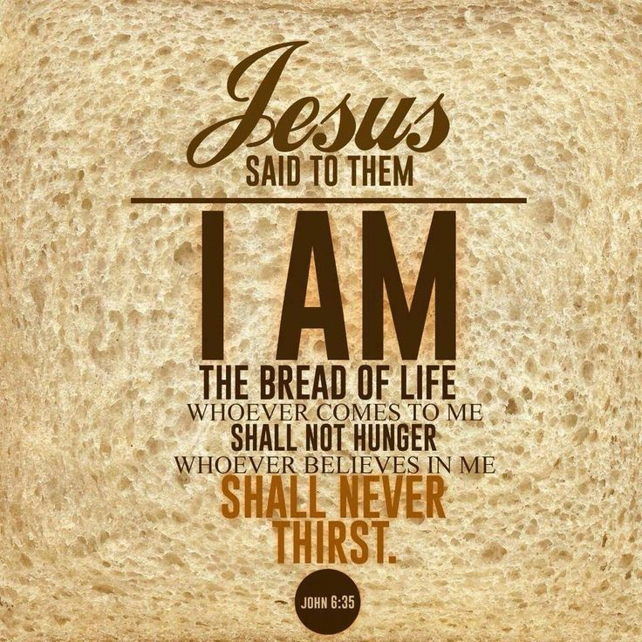
Jesus in his own words
The ‘I am’ sayings of Jesus

Slide 2
Jesus be the centre…
The claim to divinity
Exodus 3.14, ‘I am who I am’
John 8. 54-58, ‘Before Abraham was born I am!’
Notes:
Exodus 3.14
4 Hebrew consonants
Yahweh
I am who I am or, I will be who I will be…
Speaks of the freedom and power and sovereignty of God.
The name was rarely spoken
John 8.54-58

Slide 3
The call for Jesus to be the centre of our lives…

Slide 5
Life now and life in the age to come
Vs32-33
v40

