Slide 1
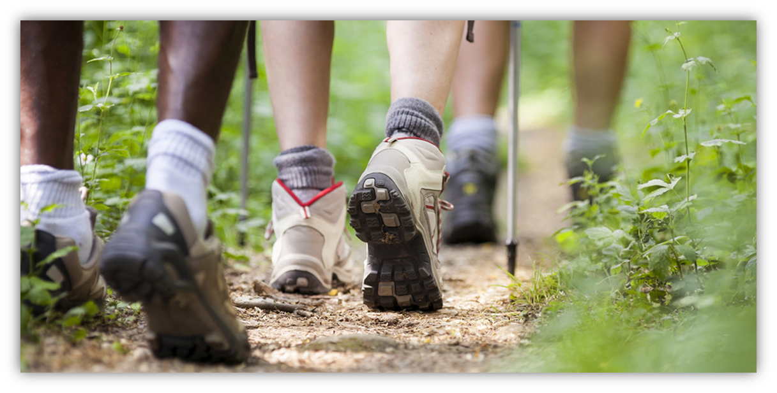
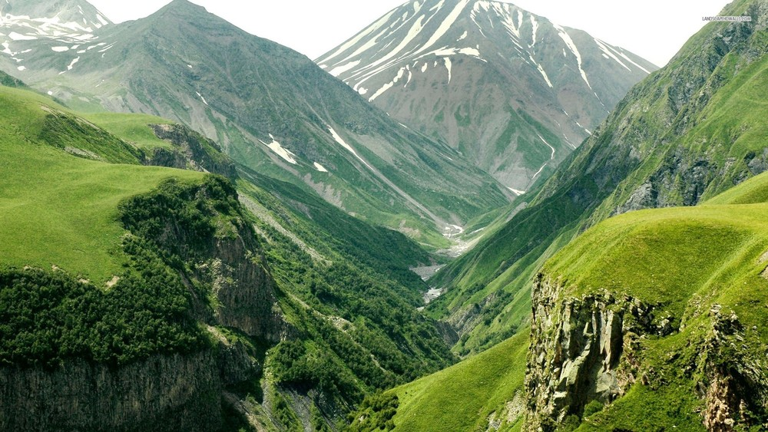
Discipleship Glory on the mountain; glory in the valley

Slide 2
Saying ‘no’ to self and ‘yes’ to following Jesus: Mark 8.34-35
Give Jesus full control
Saying yes to following Jesus means saying yes to mission and prayer (9.14-32)

Slide 3
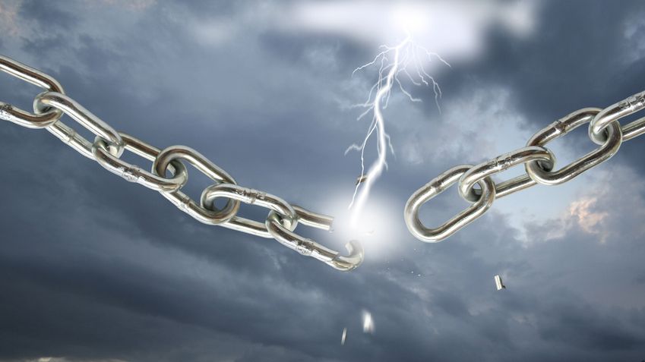
mission
The mission Jesus engages in sets people free

Slide 4
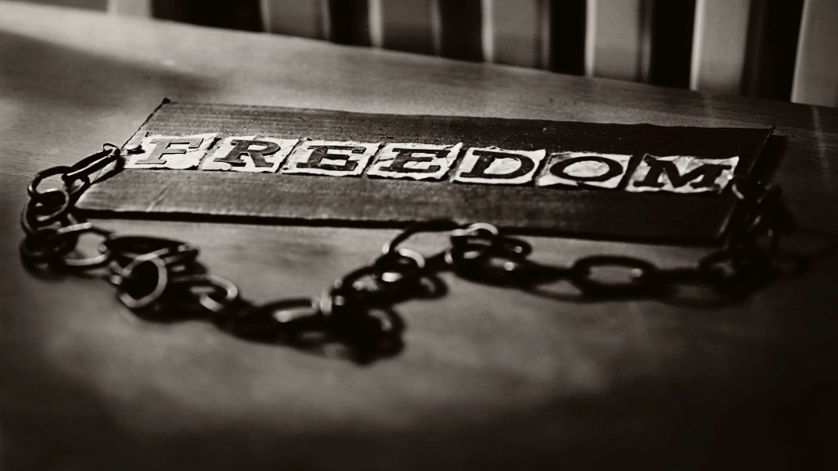
mission
Jesus’ mission is not easy, and following him in mission will not be easy

Slide 5
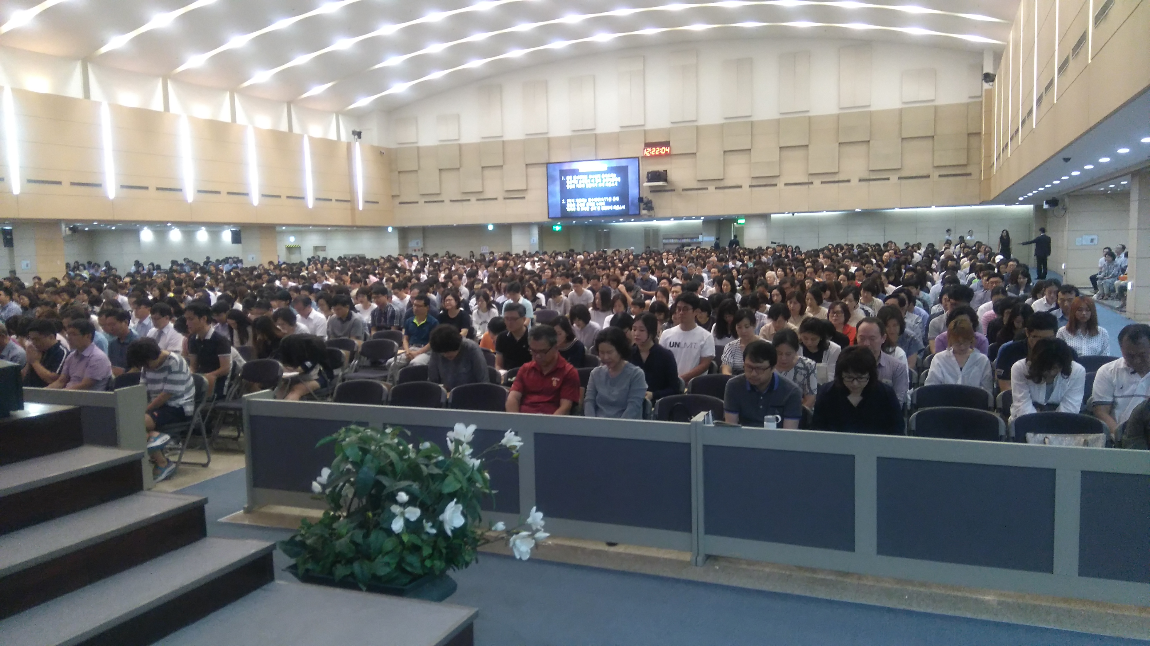
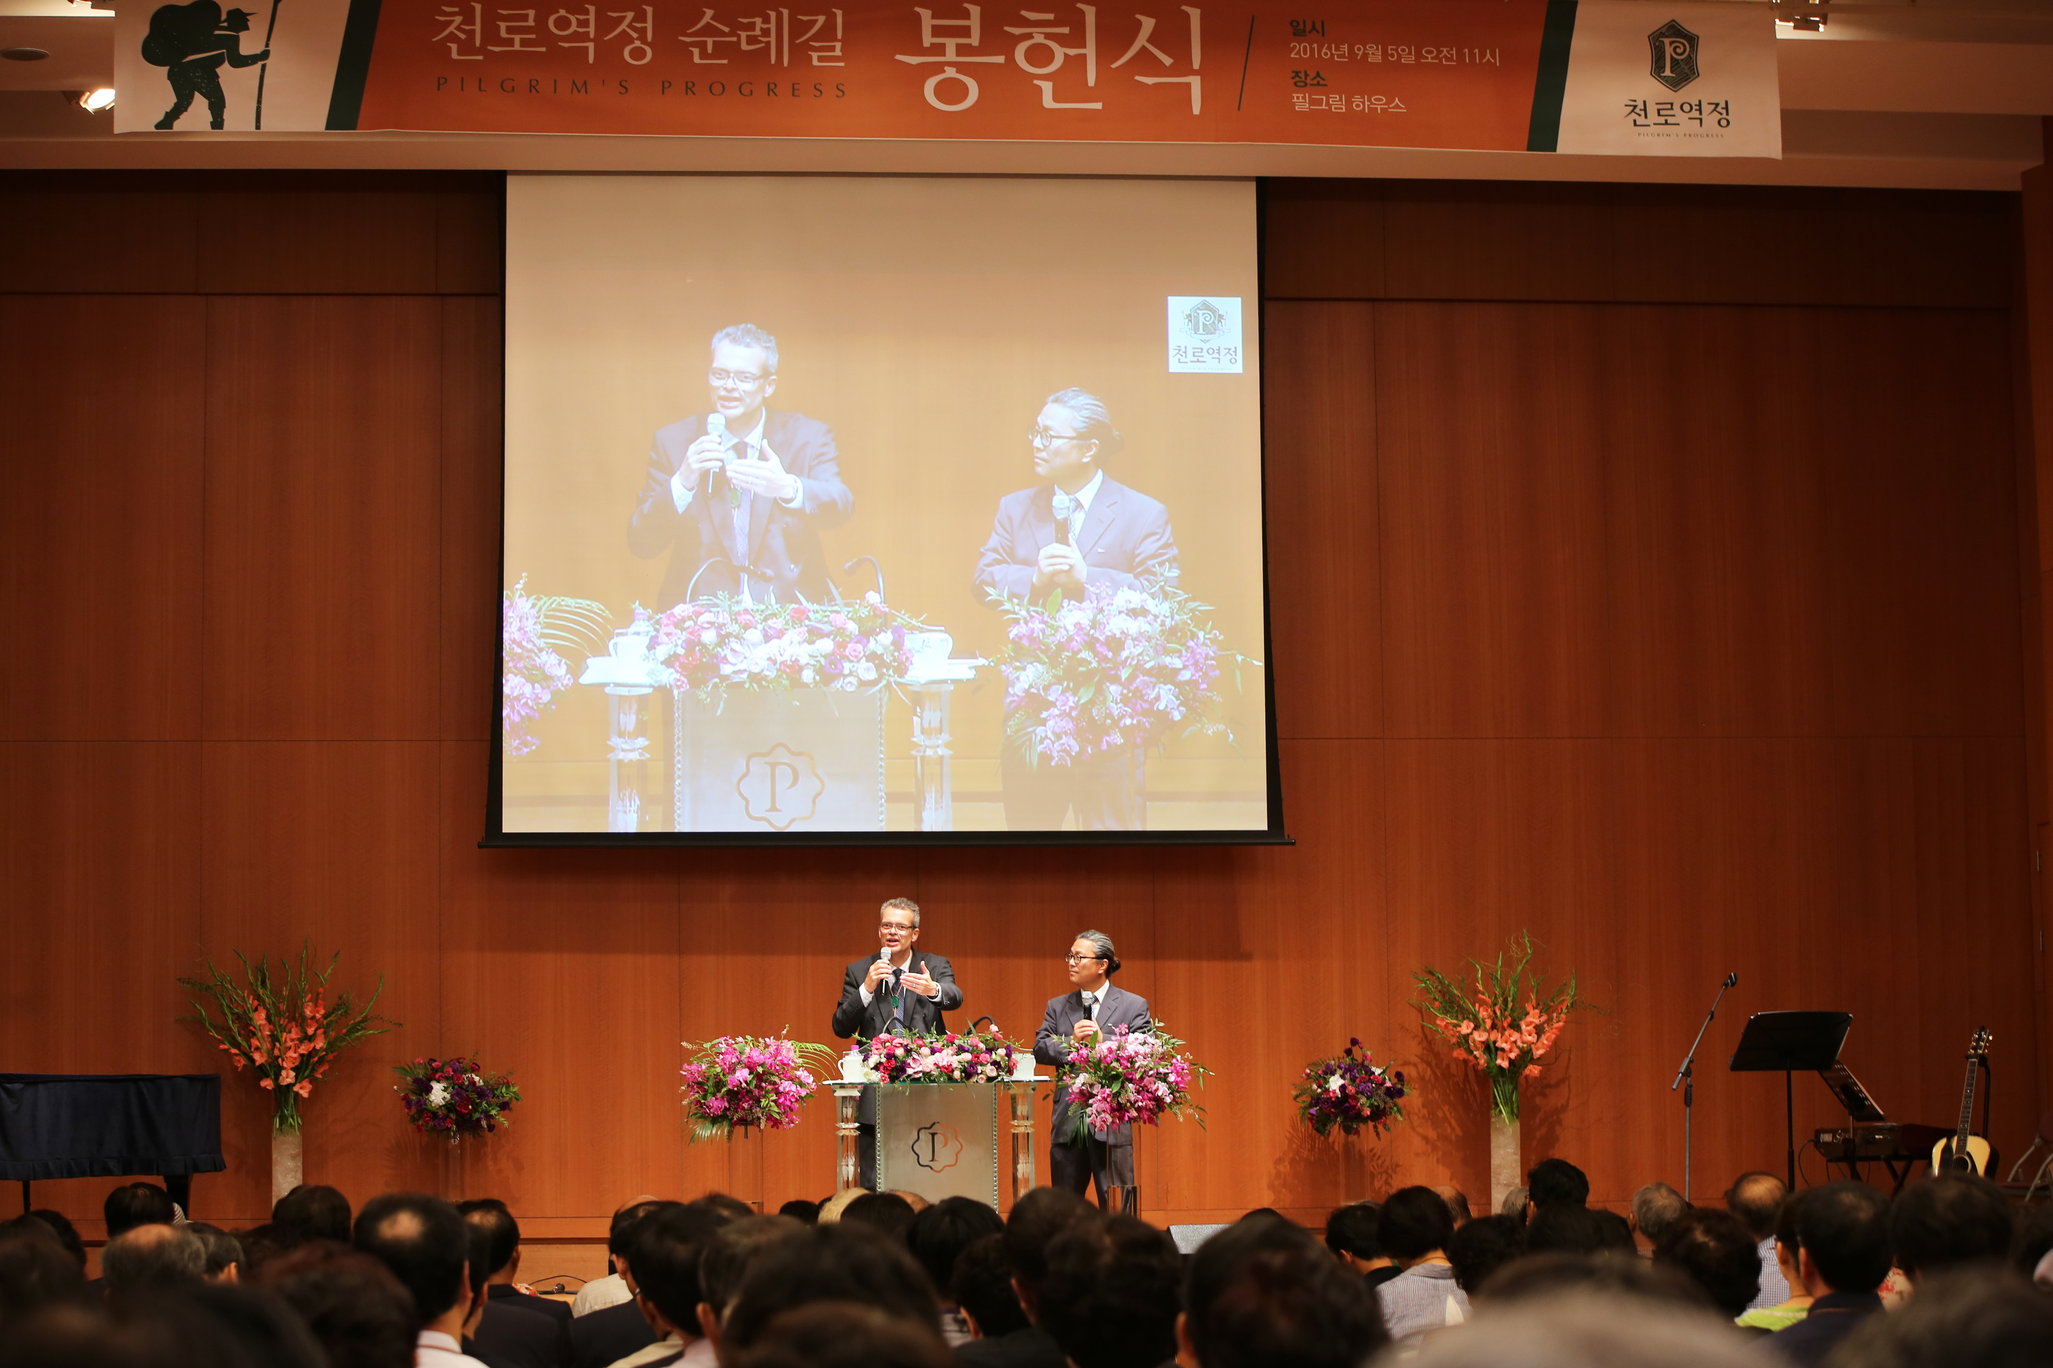
prayer
…only by prayer v29

Slide 7
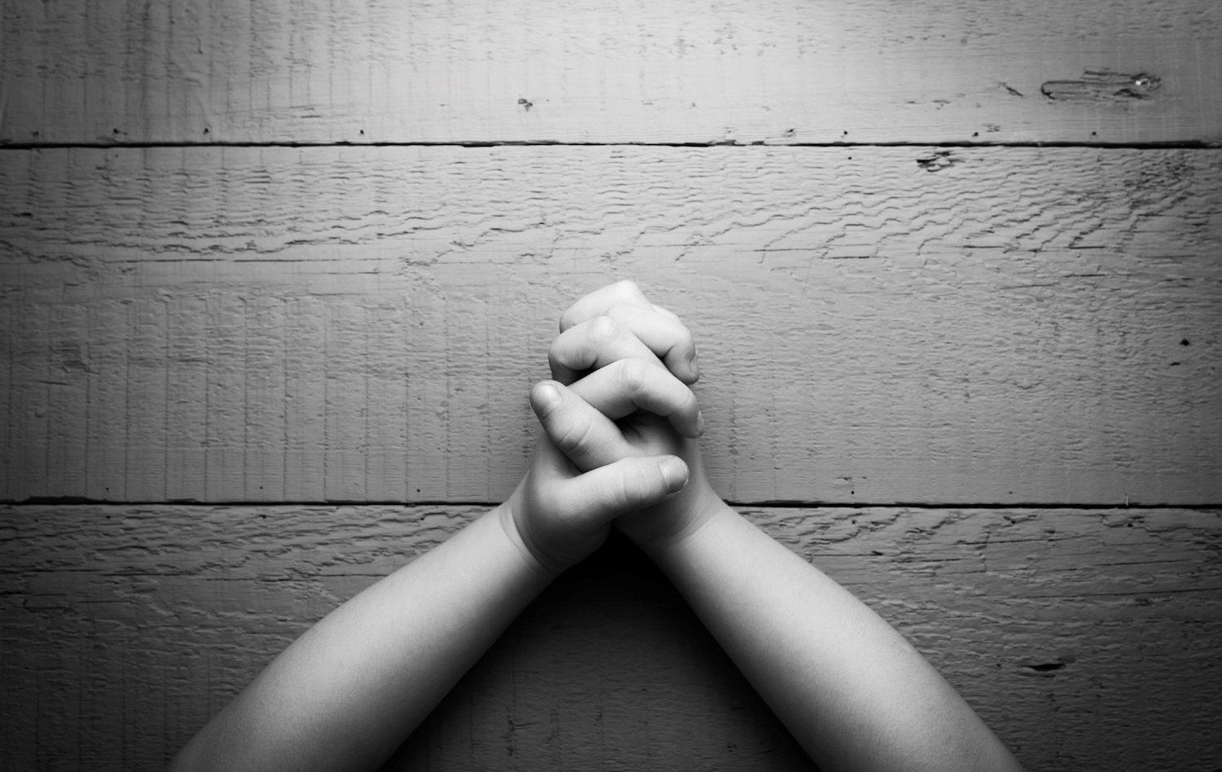
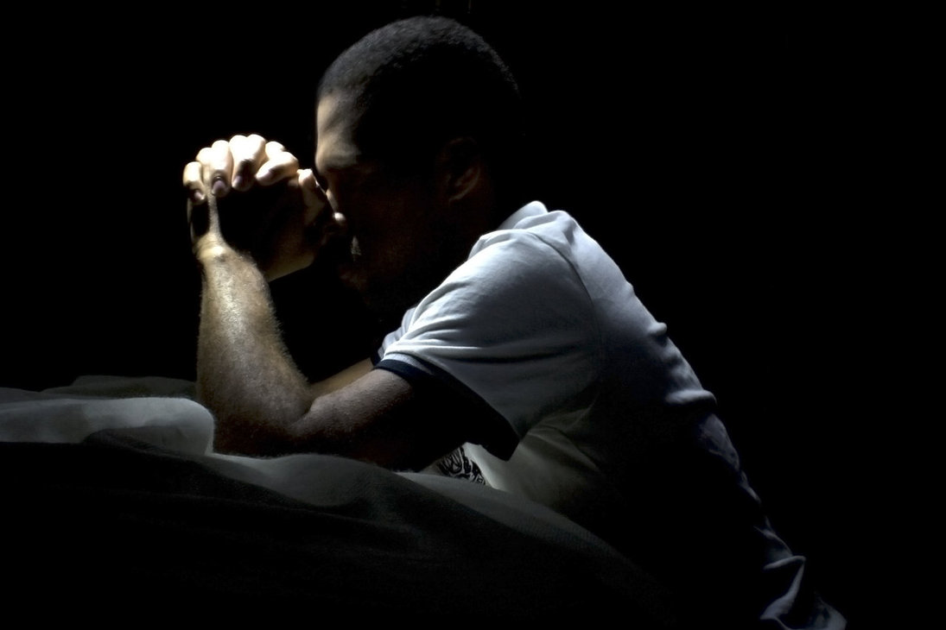
Prayer
Conversions and baptisms…
Lives healed…
Communities transformed…
Mission Communities…
Leaders trained and released…
Practical problems solved…
Global mission…
Only by prayer

