Slide 1
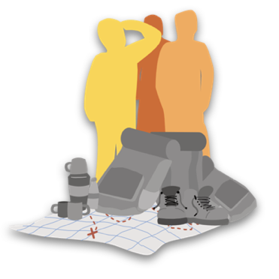
Seeking Growth
* Using Disciplines *
Engaging Mission
Sharing Fellowship
Notes:
This is the one we might want to skip. It sounds heavy. Who likes to be disciplined?
This isn’t discipline in the ‘telling off’ sense. It’s much more to do with living a disciplined life, engaging in disciplined habits of devotion.
But we can still see this as negative.
Seeking growth, yes; engaging in mission, yes – let’s get out there and get stuck in; sharing fellowship, that sounds great. Using spiritual discipline. Well, let’s pass over that one.
However, I want argue that number 2 on this list is crucial if we want the other three. It’s a crucial building block if we’re really going to go deeper with God and know his power in mission and ministry.

Slide 2
Prayer (e.g. Matthew 6.5-11)
Bible Reading (e.g. Psalm 119)
Fellowship (e.g. Hebrews 10.23)
Fasting (e.g. Matthew 6.16-18)
Communion or Lord’s Supper
(1 Corinthians 11.23-26)

Slide 3
Disciplines as a place of ‘encounter’
Here is where we encounter God
Matthew 6.6, 9-13, 16,19-21
God rewards us – with his very self
Notes:
First, what is promised…
This is where we encounter God and it’s breathtakingly wonderful.
v6 Father – wonderful, abba. An intimate word.
Repeated in v9 and elsewhere.
He invites us to worship, he provides what we need day by day, he forgive us, he delivers us, he calls us to join with him in the work of his Kingdom in the world.
It’s all extraordinary.
As we engage in these spiritual disciplines, prayer, fasting, and the other three we encounter God. He provides, gives us forgiveness, calls us into his purposes. But ultimately he gives himself.
This is more solid than earthly treasure.
Bring out the ‘reward’ aspect
v6, v16, v18, vs19-21
It’s unmistakable. We can’t miss it.
Prosperity theology? No?
That’s the wrong type of treasure. But as we seek God through these spiritual disciplines God rewards us with his very self.
Solid joys and lasting treasure none but Zion’s children know

Slide 4
Spiritual Disciplines are
Means of Grace
They are means to pursue God
God ‘blesses’ us through them
Notes:
There is a link between fasting and reward
There is a link between prayer and reward
As we read the scriptures, as we engage in mission, as we share fellowship – there is reward…
Means of grace
Ways that God conveys his grace. Not just Wesleyan. Many theologians before and since.
Illustration
Me and Anne at Hdly
God mediates his grace through people.

Slide 5
Our culture militates against disciplined engagement with spiritual disciplines
Notes:
Rather than persevering, we often prefer quick fix solutions, short cuts which will get us where we want to go with a minimum of effort. I recall a headline in a fitness magazine: ‘Lose weight while you sleep.’ This attention-grabbing headline certainly served its purpose: getting someone like me to read the article. But what was written was disappointing. Readers were essentially told that if they were high-flying executives, getting by on four hours sleep a night and occasional power-napping, then they needed more sleep. This is surely true, but is it really in and of itself an effective weight loss programme? We want maximum results with minimum effort. But life rarely works like that.
In addition, we have a tendency to flit from thing to thing. Our culture encourages what Gore Vidal once described as ‘a passion for the immediate and the casual’. We do not want to persevere in something. We are easily bored, easily distracted. The Danish philosopher Søren Kierkegaard compared us to the flat stones we sometimes send skimming across a lake. The stone ‘skips lightly for a time, but as soon as it stops skipping, [it] instantly sinks down into the depths’. We ‘skip’ from one thing to another, never settling at anything, perhaps afraid that if we stop and consider our situation we will sink without a trace.

Slide 6
Dare to be disciplined in…
Prayer (e.g. Matthew 6.5-11)
Bible Reading (e.g. Psalm 119)
Fellowship (e.g. Hebrews 10.23)
Fasting (e.g. Matthew 6.16-18)
Communion or Lord’s Supper
(1 Corinthians 11.23-26)
Notes:
Jesus expects us to engage in a disciplined way…
v11 – give us today our daily bread
As they exercised daily discipline, God met with them and fed them.
We need to engage in the disciplines in a disciplined way

Slide 7
Patterns not Padlocks
Set aside a specific time
Plan what you’re going to do
Don’t give up and don’t feel defeated

Slide 8
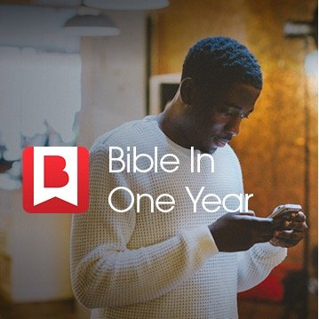
A daily rhythm of prayer
https://www.24-7prayer.com/dailydevotional
https://www.bibleinoneyear.org/
Take time to meet with others
Small group, Gatherings
Be expectant as you come to God

