Slide 1
Acts 2-4, especially.42-47; 4.31 The Call to Discipleship Four priorities

Slide 2
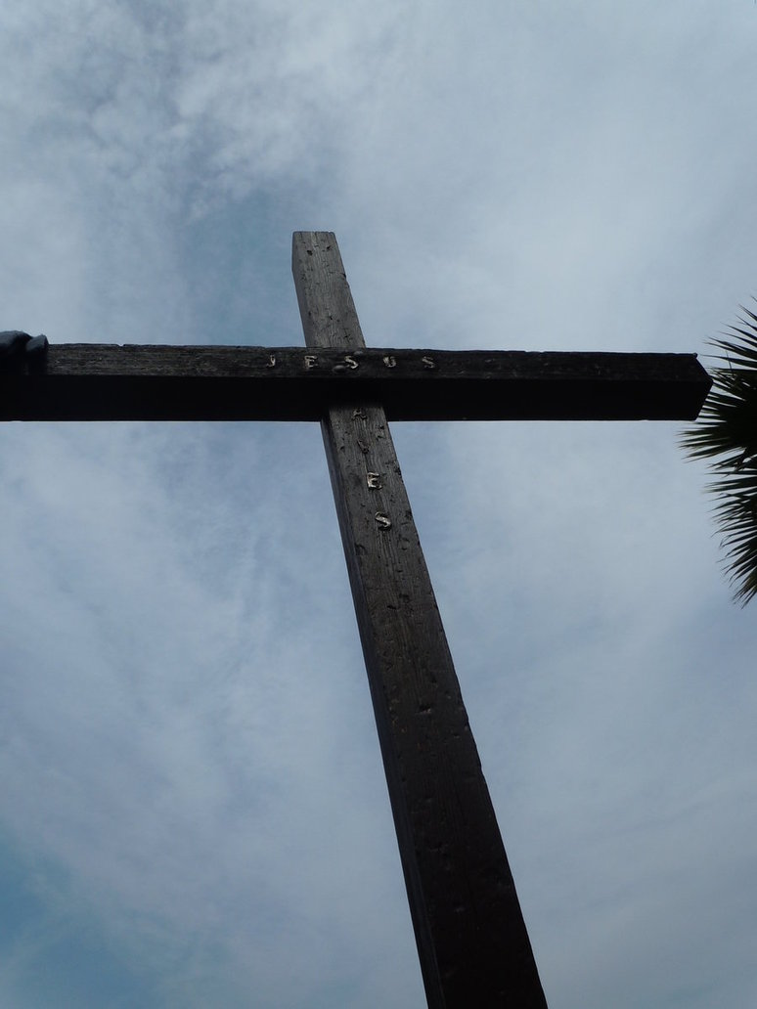
1. Take a stand
The early disciples were confident, courageous, and full of joy.
Acts 4.12-13

Slide 3
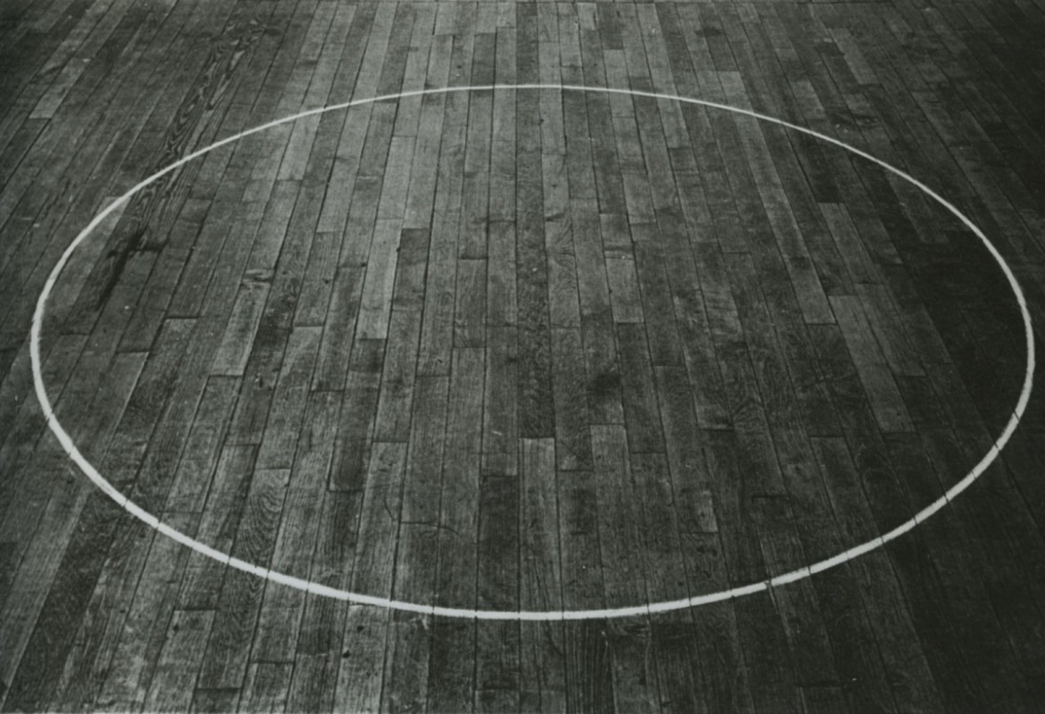
2. Draw a circle
Acts 2.42
Revival starts with me

Slide 4
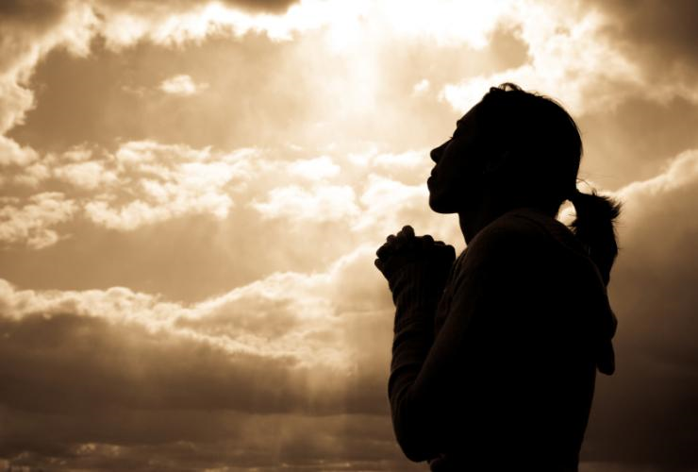
3. Say a prayer
Acts 2.42; 4.31
Our prayer week begins 8 October but don’t wait!

Slide 5
4. Take a step
Acts 2.38-41
Acts 4.31
Many other examples. What step is God calling you to take?

