Slide 1
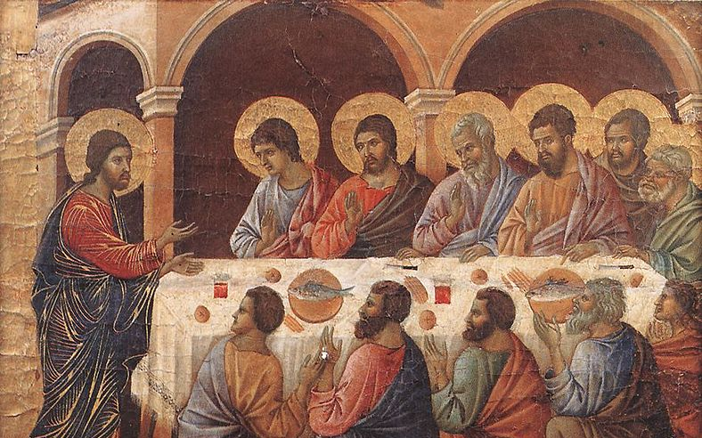
Jesus Appears to His Disciples
Why The Resurrection Had to Happen
Luke 24:36-49
John 20:19-23
Jesus Appears to Disciples - Duccio di Buoninsegna - c1308

Slide 2
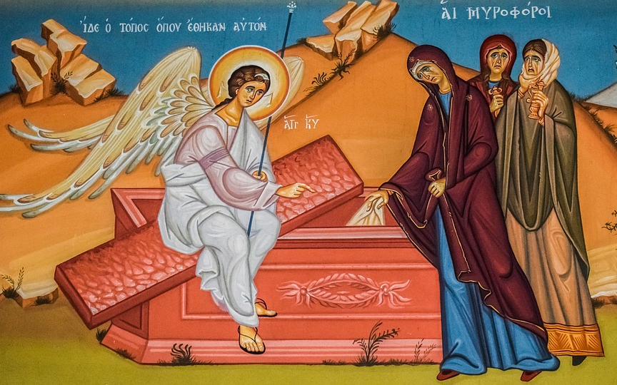
What Happened After Friday?
Jesus Buried
Matt. 27:57-61
John 19:39
Priests and Pilate Meet – Set Guards
Matt. 27:63-66
Mary etc. Find Tomb Empty
Matt. 28:1-7
Mark 16:1-8
Mary Magdalene
Luke 24:1-11
John 20:1-2
Mary, wife of Clopas
Mary, mother of James
Joanna
Salome

Slide 3
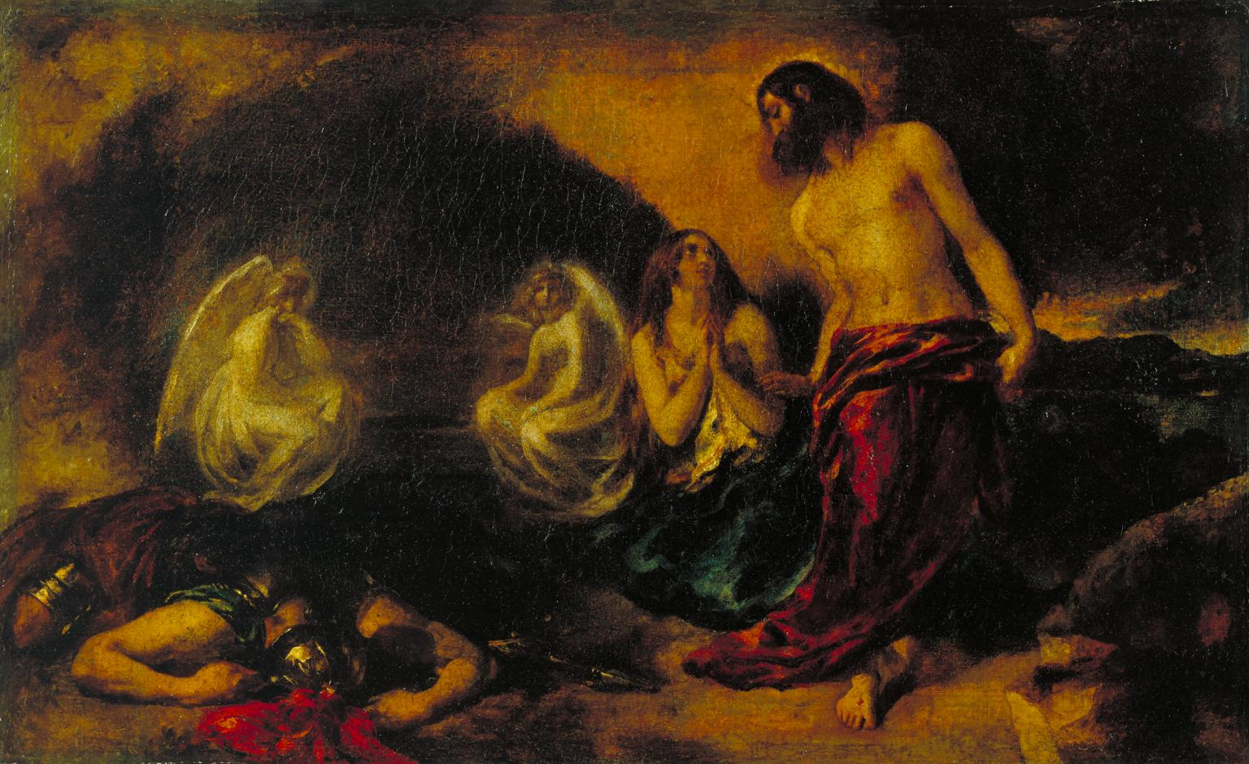
What Happened After Friday?
Jesus Appears to Mary and Others
Matt. 28:8-10
Mark 16:9-11
John 21:11-18
Jesus Appears to Mary – William Etty - 1834

Slide 4
What Happened After Friday?
Peter and Other Disciple (John?) Find Tomb Empty
Luke 24:12
John 20:3-9
Appears to Peter
Luke 24:34
1 Cor. 15:3-5
Guards Report to Priests – Cover-Up
Matt. 28:11-15
Mary Announces The Resurrection – St Albans Psalter – 1120s
Jesus Appears to Mary – William Etty - 1834

Slide 5
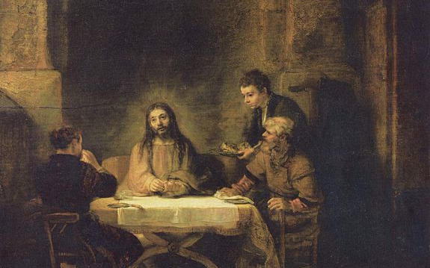
What Happened After Friday?
Jesus Meets Disciples on Road to Emmaus: Cleopas & Other
Mark 16:12-13
Luke 24:13-32
Chalphai = Alphaeus?
Supper at Emmaus – Rembrandt – 1648

Slide 6
What Happened After Friday?
“Whilst they were still talking about this…”
Jesus Appears to His Disciples
Mark 16:14
Luke 24:36-41
John 20:19-23
Jesus Appears to Disciples - Duccio di Buoninsegna - c1308

Slide 7
Why The Resurrection Had to Happen
Evidence and Understanding
Disciples believed but didn’t understand
Our sins had been paid for on the cross - Success
Different to other crucifixions
“Seeing what was to come, He spoke of the resurrection of the Messiah, that He was not abandoned to the realm of the dead, nor did His body see decay. God has raised this Jesus to life, and we are all witnesses of it” – Acts 2:31-32
Jesus Appears to Disciples - Duccio di Buoninsegna - c1308

Slide 8
Why The Resurrection Had to Happen
To Fulfil God’s Promises
“Everything must be fulfilled that is written about me in the Law of Moses, the Prophets and the Psalms” – Luke 24:44
“You will not let Your Holy One see decay” - Psalm 16:10
Supper at Emmaus – Rembrandt – 1648

Slide 9
Why The Resurrection Had to Happen
More Than a Helping Hand
“Who then is the one who condemns? No one. Christ Jesus who died—more than that, who was raised to life—is at the right hand of God and is also interceding for us. Who shall separate us from the love of Christ?” – Romans 8:34-35
Jesus Appears to Mary – William Etty - 1834

Slide 10
Why The Resurrection Had to Happen
A Relationship Restored
“We were therefore buried with him through baptism into death in order that, just as Christ was raised from the dead through the glory of the Father, we too may live a new life. For if we have been united with him in a death like his, we will certainly also be united with him in a resurrection like his.” – Romans 6:3-5
Jesus Appears to Disciples - Duccio di Buoninsegna - c1308

Slide 11
Why The Resurrection Had to Happen
Eternity Secured
“By his power God raised the Lord from the dead, and he will raise us also” – 1 Corinthians 6:14
Jesus Appears to Disciples - Duccio di Buoninsegna - c1308

Slide 12
Why The Resurrection Had to Happen
To Lead The Way
“But Christ has indeed been raised from the dead, the firstfruits of those who have fallen asleep… so in Christ all will be made alive” – 1 Cor. 15:20,22
Jesus Appears to Disciples - Duccio di Buoninsegna - c1308

Slide 13
Why The Resurrection Had to Happen
Jesus Glorified
“But God raised him from the dead, freeing him from the agony of death, because it was impossible for death to keep its hold on him” – Acts 2:24
“Then I saw a Lamb, looking as if it had been slain, standing at the centre of the throne” – Revelation 5:6
Jesus Appears to Disciples - Duccio di Buoninsegna - c1308

Slide 14
Why The Resurrection Had to Happen
A New Covenant
“And if the Spirit of Him who raised Jesus from the dead is living in you, He who raised Christ from the dead will also give life to your mortal bodies because of His Spirit who lives in you” – Romans 8:11
Jesus Appears to Disciples - Duccio di Buoninsegna - c1308

Slide 15
Why The Resurrection Had to Happen
God Shows His Nature
“For God so loved the world that He gave his one and only Son, that whoever believes in Him shall not perish but have eternal life” – John 3:16
Jesus Appears to Disciples - Duccio di Buoninsegna - c1308

Slide 16
Not What We Expected
John 20:8-9 - “Saw and believed… did not understand”
Luke 24:20 – “Hoped he was the one to save Israel”
Guards – Eyewitnesses who denied for a price
Jesus Appears to Mary – William Etty - 1834

Slide 17
Not What We Expected
John 20:8-9 - “Saw and believed… did not understand”
Luke 24:20 – “Hoped he was the one to save Israel”
Guards – Eyewitnesses who denied for a price
Chief Priests – The wrong sort of Messiah?
Jesus Appears to Mary – William Etty - 1834

Slide 18
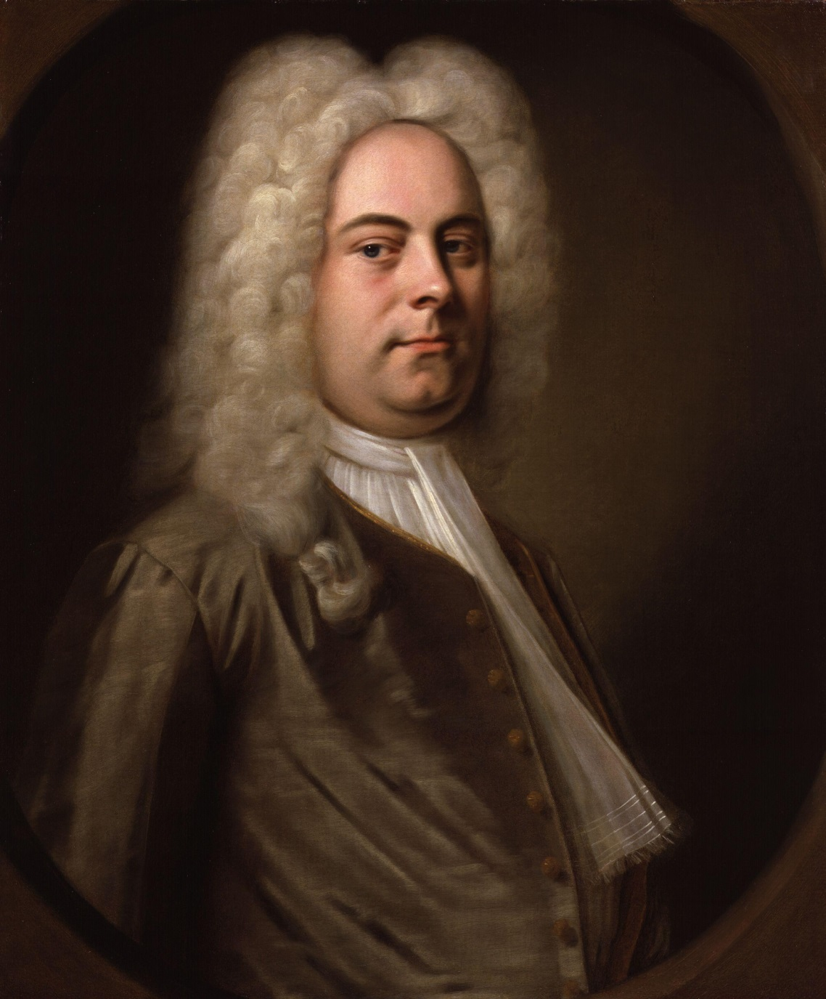
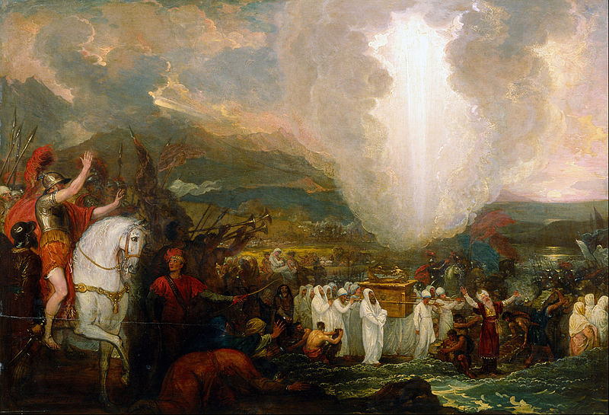
“See the Conquering Hero Come”
Joshua - 1747
Joshua Crosses the River Jordan
– Benjamin West – 1800
G F Handel – Balthasar Denner – c1726

Slide 19
Not What We Expected
John 20:8-9 - “Saw and believed… did not understand”
Luke 24:20 – “Hoped he was the one to save Israel”
Guards – Eyewitnesses who denied for a price
Chief Priests – The wrong sort of Messiah?
Zealots – The wrong sort of Messiah?
Jesus Appears to Mary – William Etty - 1834

Slide 20
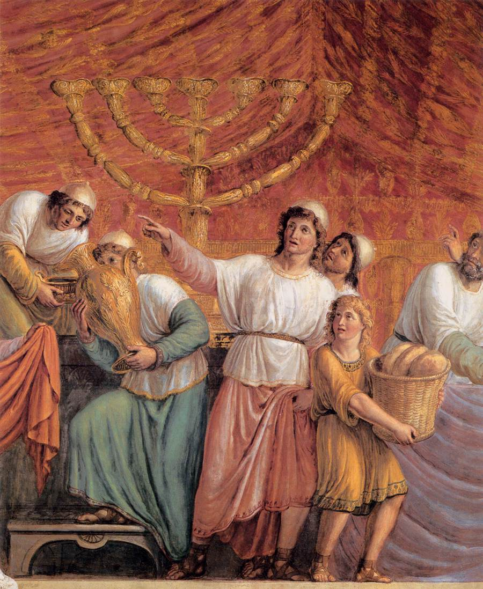
“See the Conquering Hero Come”
Judas Maccabeus - 1796
G F Handel – Balthasar Denner – c1726
The Menorah – Luigi Ademollo – 1800

Slide 21
The Saviour We Need…
…The Saviour We Want?
Jesus Appears to Mary – William Etty - 1834

