Slide 1
The Church God Uses Acts 11.19-30; 12.25 – 13.3

Slide 2
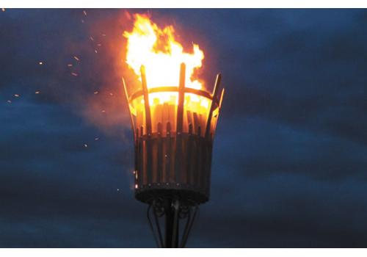
‘Hope is kindled’
Churches are called to be ‘beacons of hope’
The church in Antioch shows
us the way
Notes:
Gandalf: hope is kindled
From Jill Duff, ‘This is depicted vividly in a wonderful scene from the 2003 film The Lord of the Rings: The Return of the King. When the battle is at its worst, a little hobbit manages to climb up and light the beacon. Then you see some amazing cinematography of beacons being lit across the hills. Gandalf says, “Hope is kindled”.
What was it that made this church burn so brightly?

Slide 3
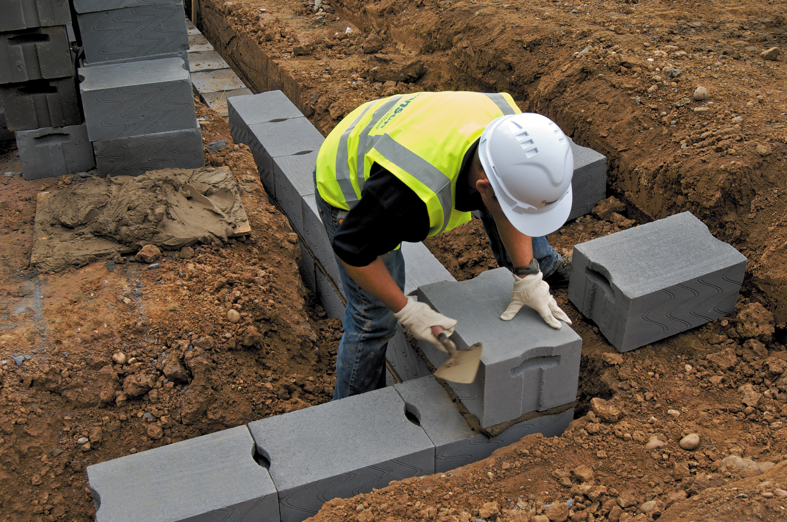
1. Grounded in Jesus and the Gospel
V20 the good news about the Lord Jesus
V23 encouraged to remain true to the Lord
Vs 25-26 helped by the teaching of Barnabas and Saul
‘The way in is the way on’
Notes:
V20 the good news about the Lord Jesus
V23 encouraged to remain true to the Lord
Vs 25-26 helped by the teaching of Barnabas and Saul
Sometimes we feel this isn’t exciting or necessary. But it is essential and wonderful.
‘The way in is the way on’
Go deeper into the things of God, of Jesus. Respond to good teaching.
Connect team time. Hebrews 12. ‘Let us hold unswervingly to the hope we profess.’

Slide 4
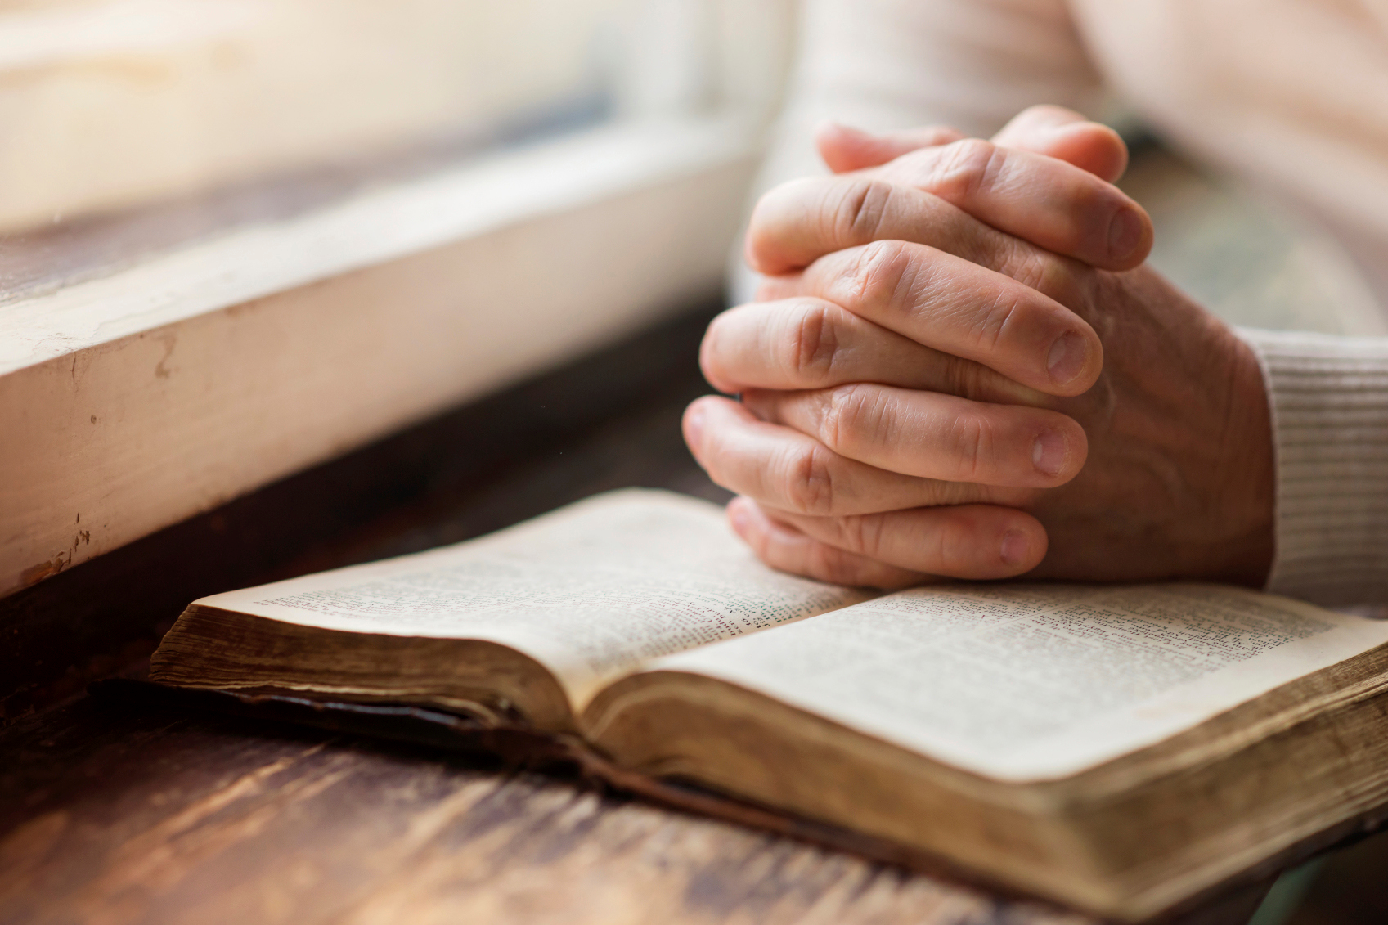
2. Praying and Fasting 13.2
Don’t neglect spiritual disciplines
As we give ourselves to God in worship and prayer and fasting, God reveals himself to us
Notes:
My new wine experience

Slide 5
3. Knowing the Presence and Activity of God v24, v28, v21
Barnabas full of faith and the Holy Spirit
Responding to a prophetic word
The Lord’s hand was with them
Notes:
V21 The Lord’s hand was with them. An image of power and authority. (Exodus 3) God’s mighty hand was with his people to free them from slavery, to bring salvation.
The same power is at work here.
There is a link between 1 and 2.
Norwegian cruise ship wreck

Slide 6
Notes:
Viking Sky
What happens if we lose power

Slide 7
4. Generous
The example of Barnabas (vs 25-26)
Financially generous (vs 29-30)
Notes:
Financially
Remind people of interns and staffing
Also sending. Commending Irene to Central Asia.
The generosity of Barnabas. Be Kingdom people. In the workplace. Counter cultural. Enable and equip others.

Slide 8
5. Missional (v24 13.1-3)
Notes:
They were grounded in the gospel but they didn’t stagnate spiritually or missionally
Difference between the Dead Sea and the Sea of Galilee

Slide 9
6. A Place to Belong (13.1-3)
Notes:
The four names
They are all male.
Dorcas / Tabitha in Acts 9; Lydia in Acts 16. Priscilla and Aquila
Single people, widowed, different backgrounds, different cultures, different races
All find a home amongst the people of God
Really important for Mothering Sunday

