Slide 1
Psalm 112
They will have no fear of bad news (v7)
Notes:
It’s not me!
When I read this…
Who is this person?
If we are going to focster a culture of adventure we will need this.

Slide 2
1/ Fears the Lord (v1)

Slide 3
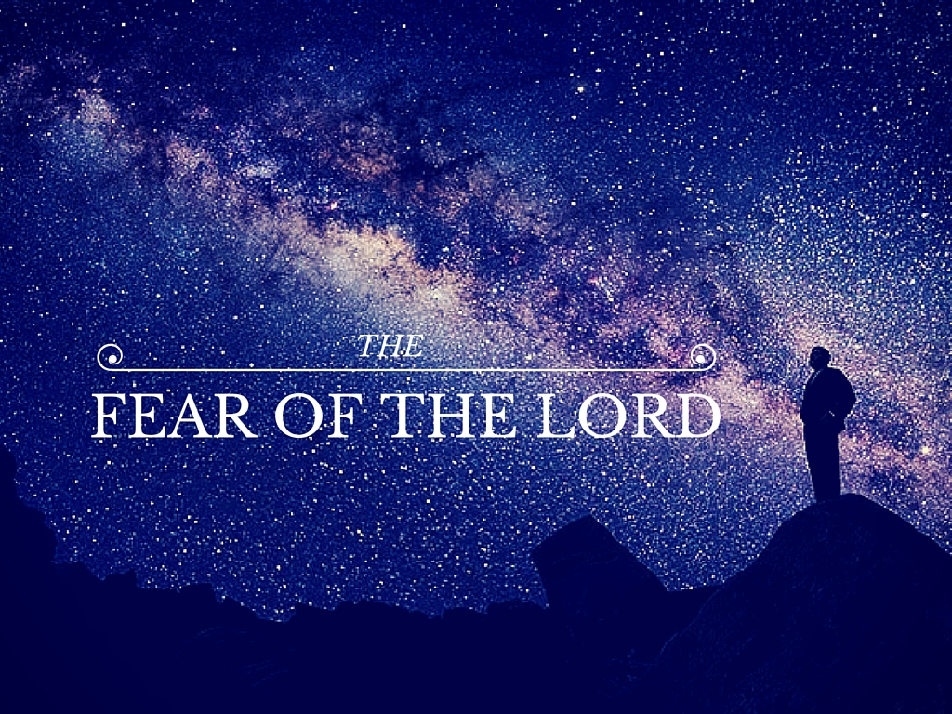
The call is to see ourselves and God in right perspective
Notes:
Theodore Roosevelt – Do you feel small enough?
We need to pause and appreciate how deeply counter cultural this is.
C18 Enlightenment – individualism, autonomy, humanism by very definition puts me at the centre.
Challenged by culture outside the west, with more emphasis on community.

Slide 4
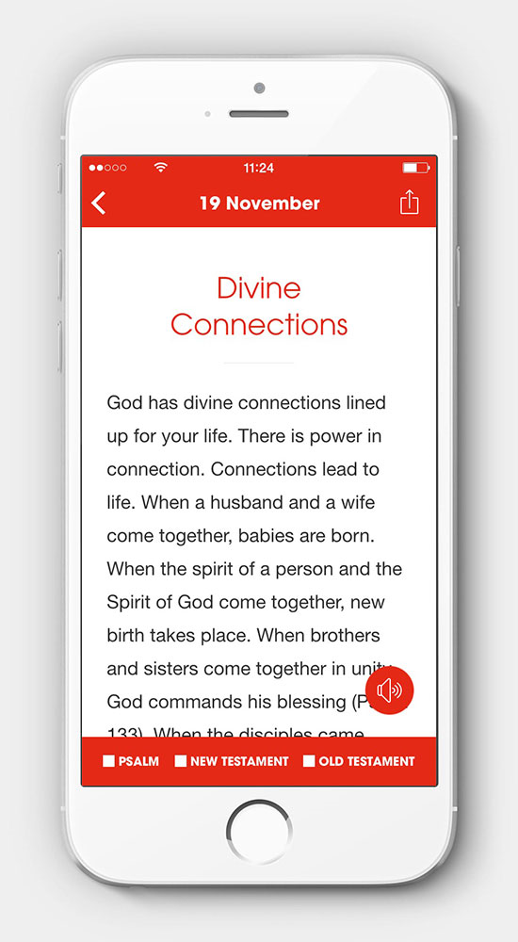
2/ Greatly Delights in God’s Commands (v1)
A sign that God is central
1 John 3.23
We come to Jesus and interpret the Scriptures as Christian people
Notes:
Not a list of rules and regulations
We are sent to Jesus, and then back to the whole of Scripture
Home Group. Don’t want to share every time. Will check that it’s okay – in case they say no, I’m going to slip another one in tonight.
Centrality of the Bible.
'My heart leaps every morning when I see Bible in One Year by @nickygumbel sitting in my inbox.'
Darlene Zschech, Worship Leader

Slide 5
3/ Generous and lends freely (v5)
In giving freely we build for the Kingdom and receive lasting treasure
Cf. Phil 4

Slide 6
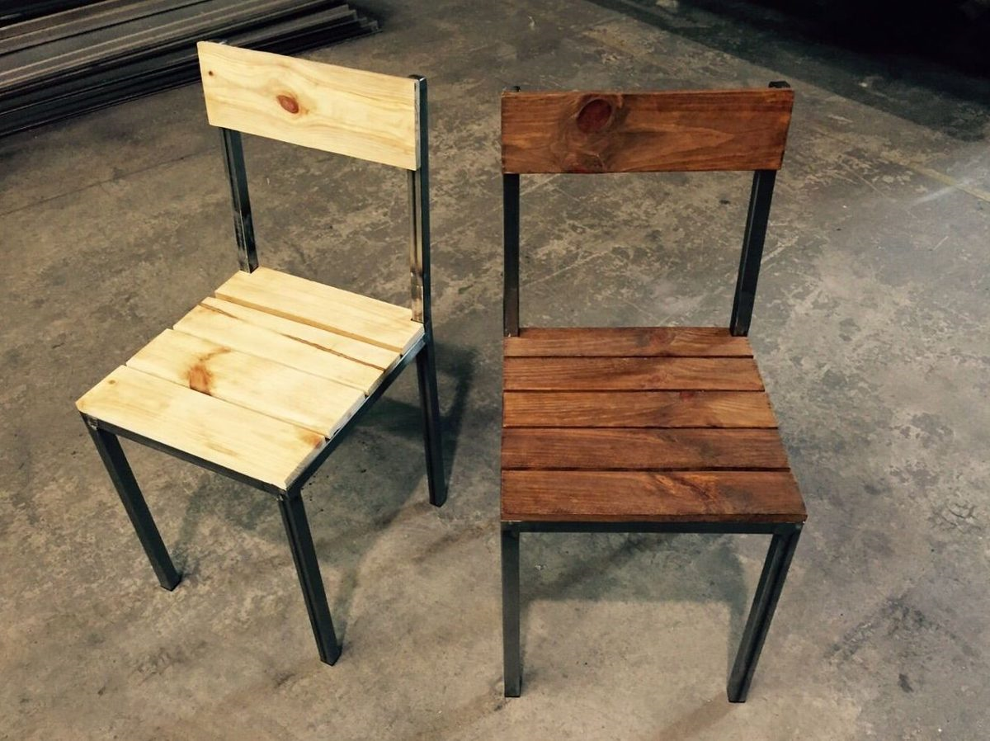
4/ Trusting God (vv7-8)
God is trustworthy Ps 111
We can lean our whole weight on him

