Slide 1
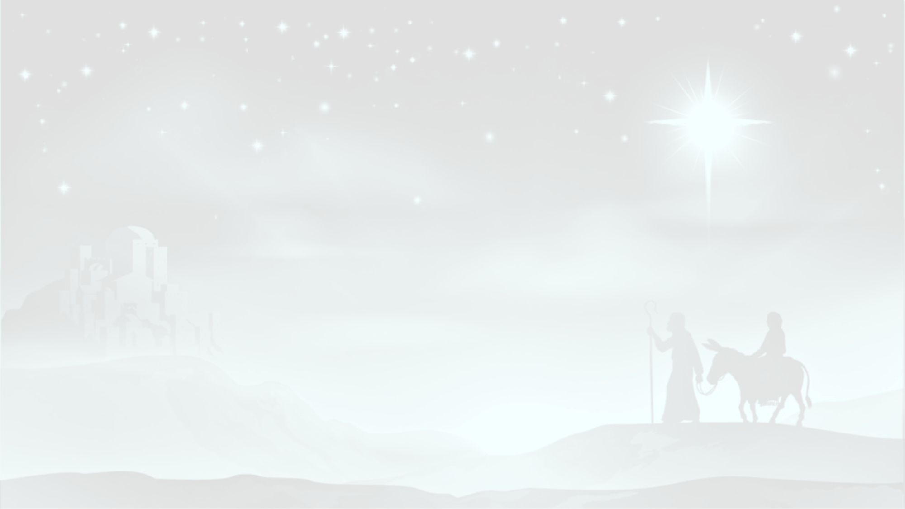
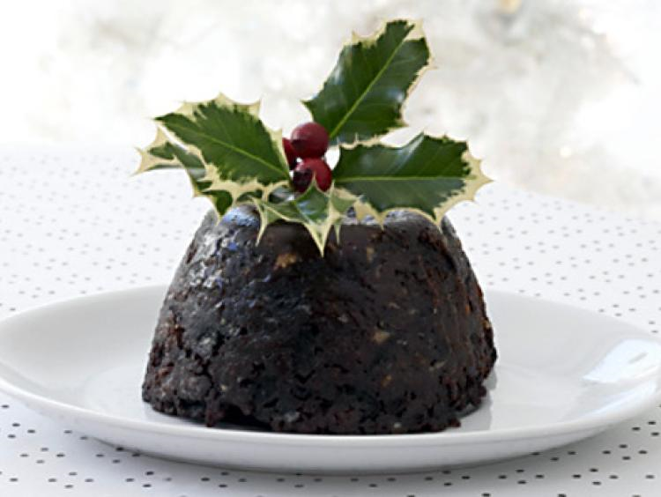
Christmas Carols by Candlelight
Different countries have different ways of celebrating Christmas

Slide 2
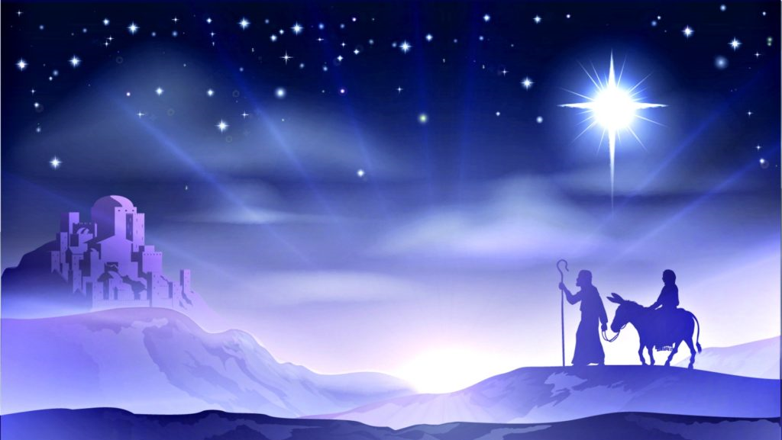
Matt 2.21 ‘You are to give him the name Jesus, because he will save his people from their sins’
Luke 2.11 ‘A saviour has been born to you’

Slide 4
‘Glory to God in the highest heaven, and on earth peace…’

Slide 6
Matt. 2 ‘Magi from the east… worshipped him’

