Slide 1
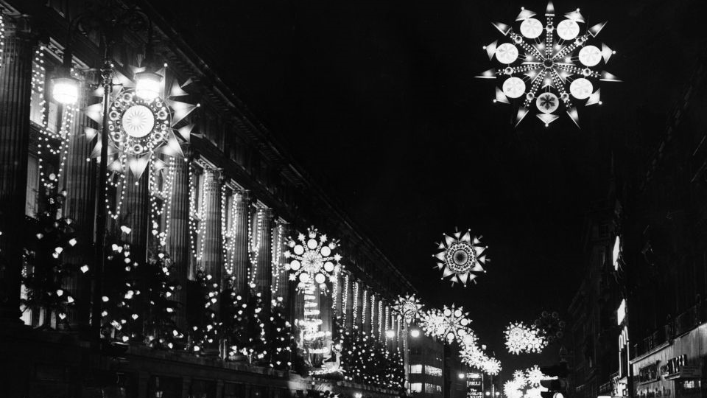
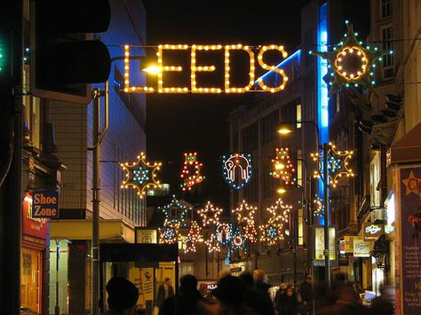
Isaiah 9.1-7 Christmas Lights and Christmas light
Christmas comes early!

Slide 2
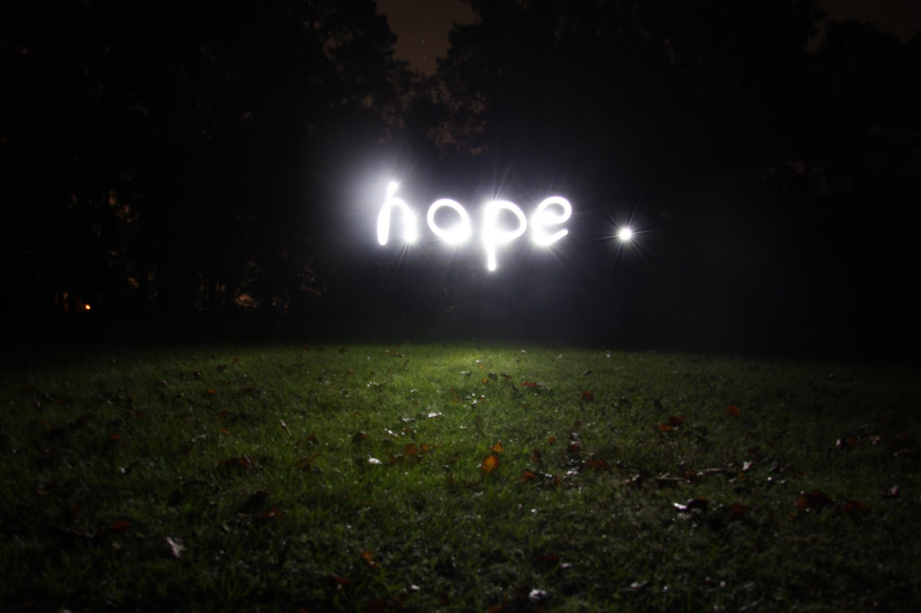
Light in the darkness v2
Jesus come to us in our gloom, distress and fearfulness

Slide 3
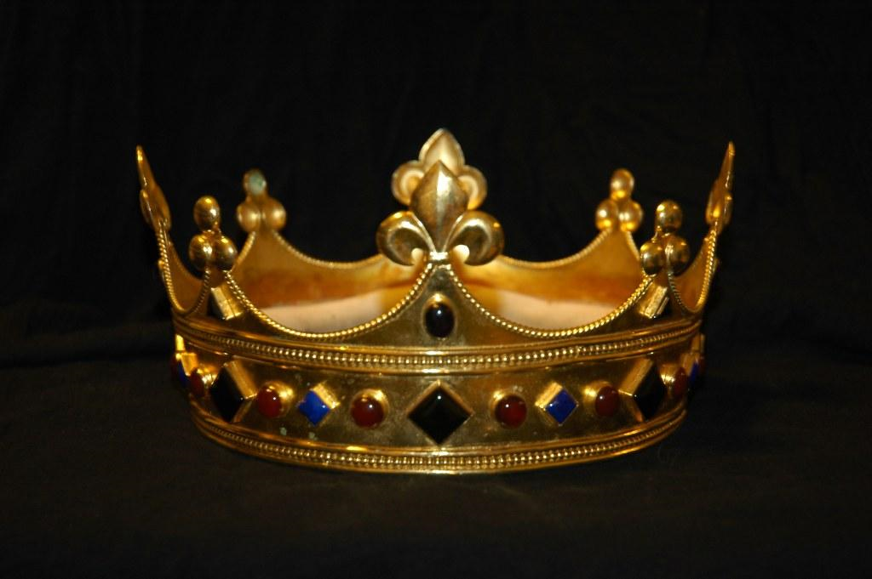
Lord, and god and ruler, vv6-7
We bow the knee before him

Slide 4
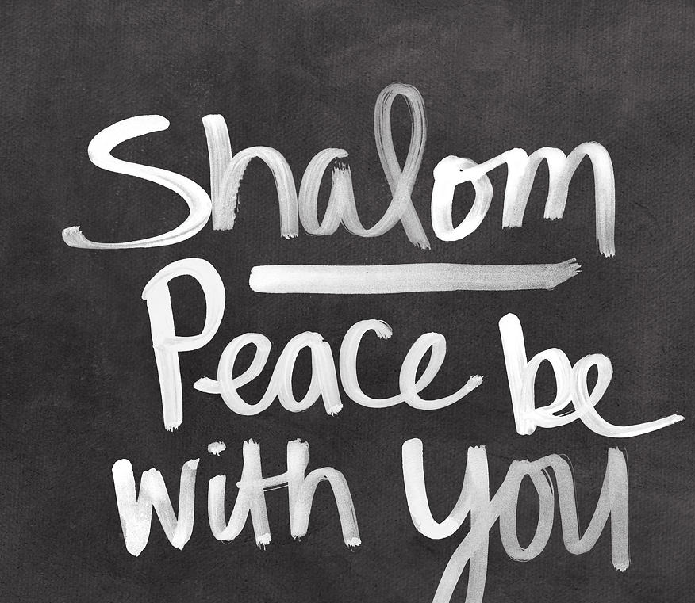
Bringing his peace, his shalom, vv7-8
Jesus brings his wholeness, his positive peace

Slide 5
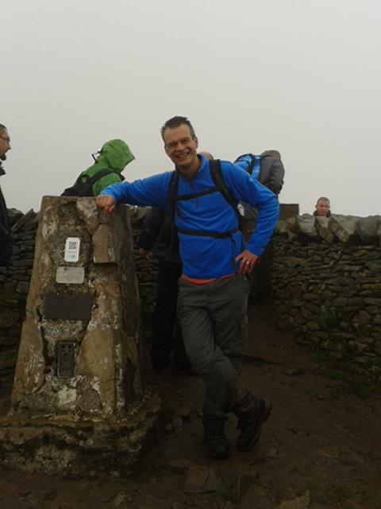
I

Slide 6
There is a fulfilment already. There is more to come

