Slide 1
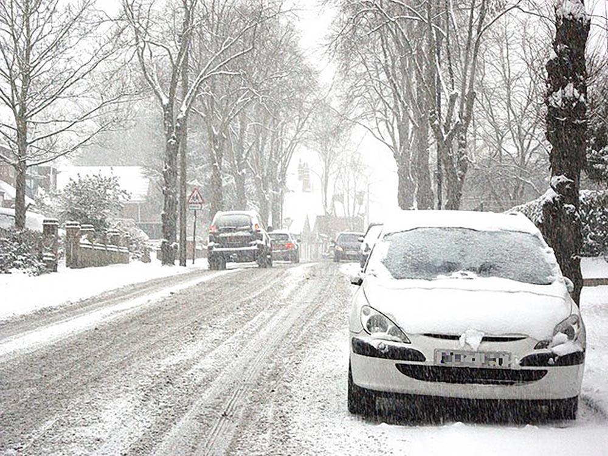
south parade together Psalm 119 (esp. vv89-112); 2 timothy 3.15-16
When a journey is difficult, we need resources to get us through

Slide 2
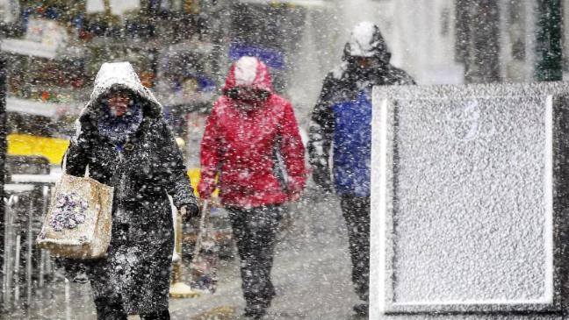
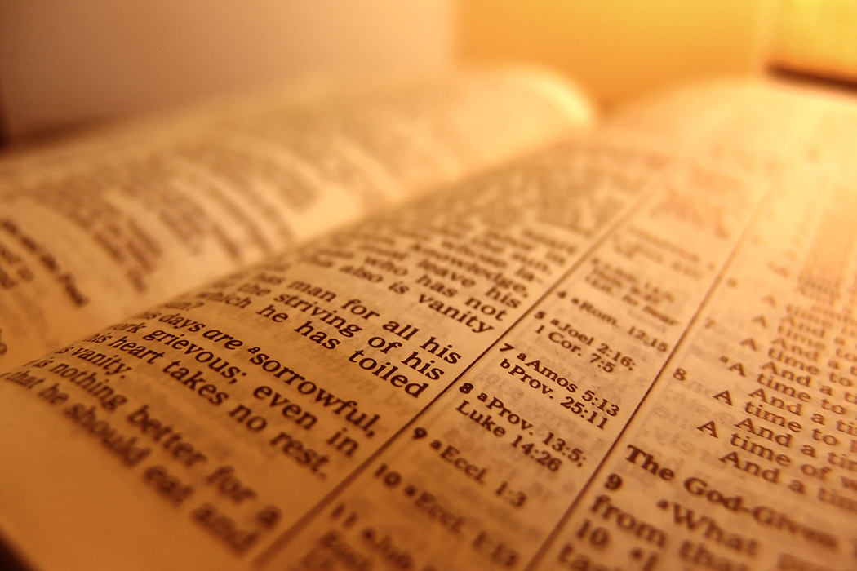
God gives us his word, the Bible, for our journey of discipleship.
The Bible is our guide (105), and our food (103-104)

Slide 3
God’s word is…
Perfect the structure of Psalm 119; the ‘God-breathed’ nature of scripture
Authoritative Psalm 119.89-90 (God spoke and the earth was established); Timothy 3.16 all scripture…is useful, teaching, rebuking, correcting and training in righteousness

Slide 4
God’s word
Brings Life Psalm 119.96
God’s commands are ‘exceedingly broad’
God’s word
Brings Life because it leads to Jesus
2 Tim. 3.15

Slide 5
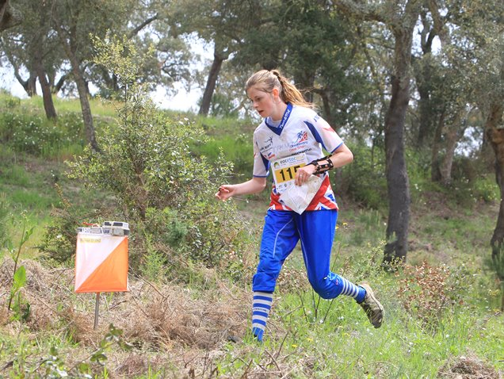
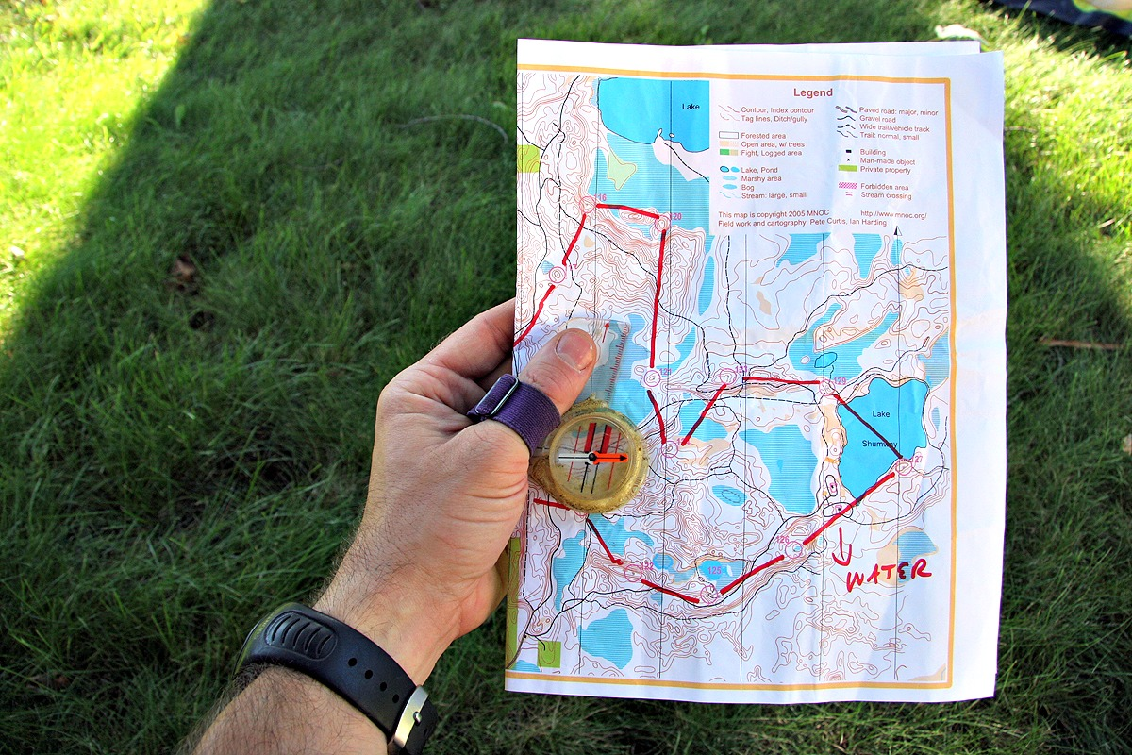

Slide 6
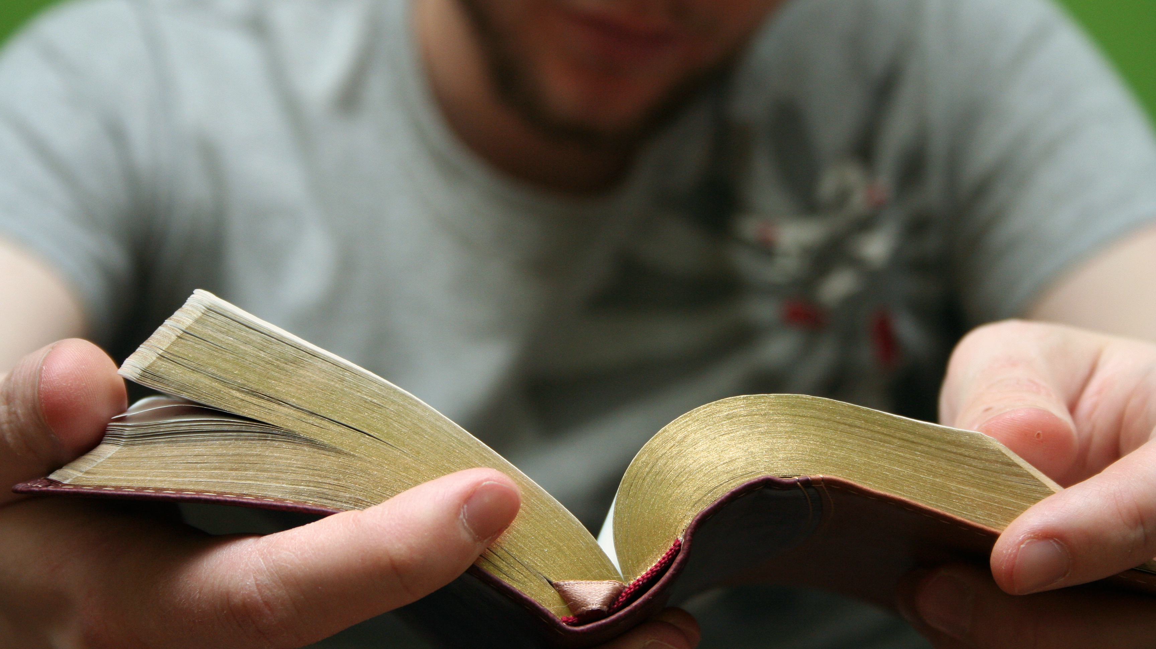
Be Disciplined
The structure of the Psalm
Psalm 119.164 ‘Seven times a day I praise you for your righteous laws’
2 Tim. 3.15 ‘how from infancy…’

Slide 7
Meditate
Psalm 119.97

Slide 8
Put into practice
Psalm 119.112
‘[T]he beauty of this psalm lies, not only in the recitation of devotion to the law, but in the Psalmists absolute devotion to the Lord.’

