Slide 1
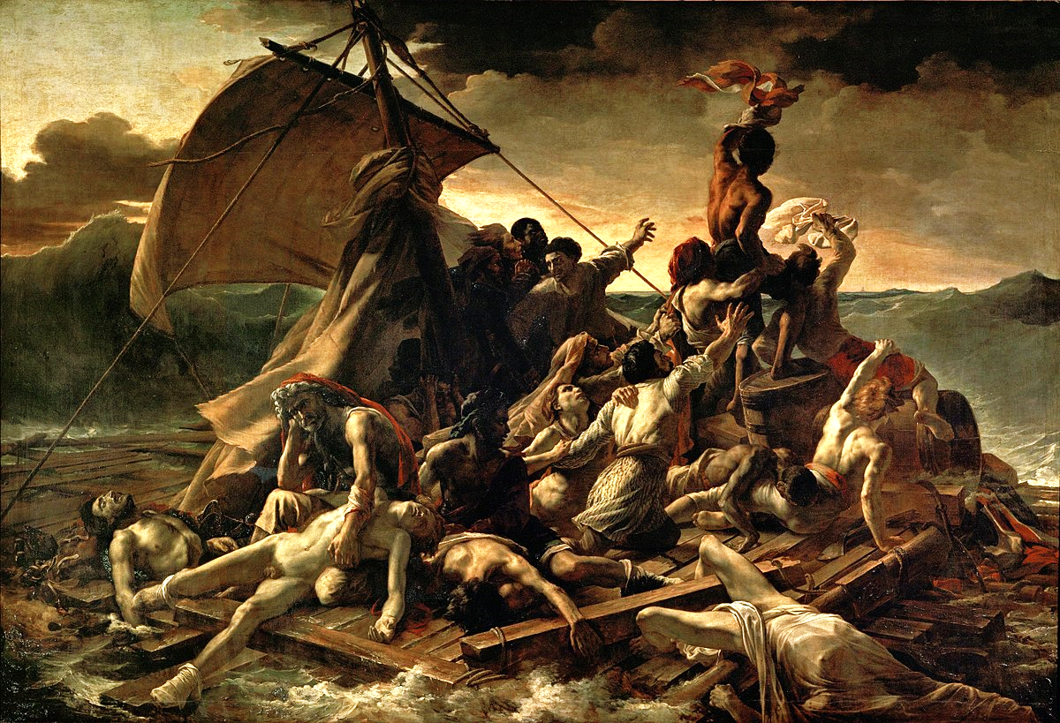
Notes:
Raft of the Medusa by Theodore Gericault
Early C19.
A French ship was lost and survivors huddled together on a small, flimsy raft.
The figures in the foreground are in despair. They appear completely broken.
But those at the other end of the raft are different.
They have spotted the ship that will rescue them.
It’s very difficult to spot. Next slide!

Slide 2
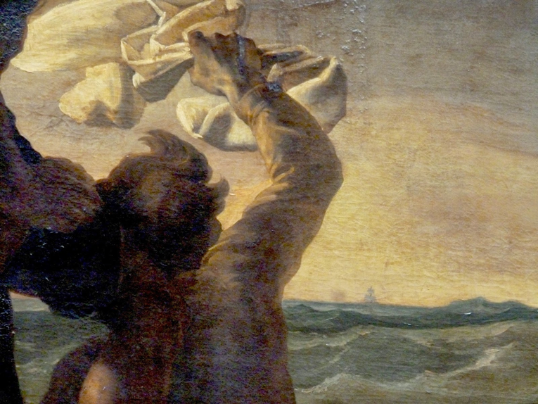
Notes:
They have spotted the ship that will rescue them.
The animating power of hope.
Where you’re looking is very important.
Are you consumed with circumstances, or are you looking away from your circumstances to something else or someone else. Someone who brings great hope to those who are in darkness.
Nehemiah was faced with a desperate situation. A situation which made him weep and morn. The wall of Jerusalem broken down, it’s gates destroyed by fire.
But although Nehemiah weeps and mourns he does not despair, because he knows where to look. He looks to God, to the power of God released through the power of prayer. He knows that God loves and longs for people to turn to him. Because he knows such a God, and he looks to him, there is hope.

Slide 3
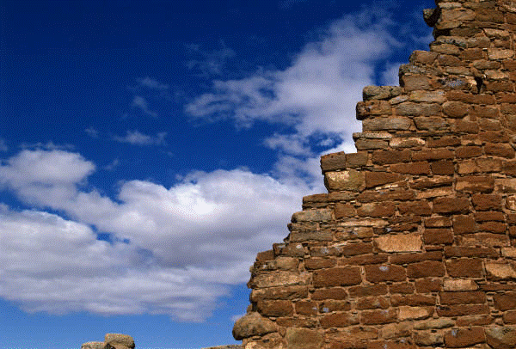
Re:Build
29 April Nehemiah 1. Prayer
6 May Nehemiah 2. Action
13 May Nehemiah 4. Perseverance
Notes:
Short series which speaks powerfully to us as a community and as a church.
(20 May is Pentecost Sunday and we’ll have a morning South Parade Together here at Headingley)
As we face our own ‘broken wall’ situations, in church and society, there is hope. Because we can look to a great and wonderful God.

Slide 4
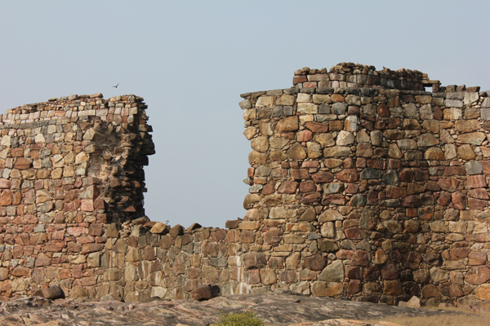
Re:Build
Nehemiah 1. Prayer
The broken wall v3
Notes:
The situation faced by Nehemiah is described vividly in v3.
“Those who survived the exile and are back in the province are in great trouble and disgrace. The wall of Jerusalem is broken down, and its gates have been burned with fire.”
A little bit of the history and background would help this come alive for us.
God’s people Israel had been taken into exile in Babylon. Babylon was taken over by a new dynasty and ruler, Cyrus, who allowed some of the Israelites to return to Jerusalem, 539BC. This was a joyful moment, but the returning exiles struggled. The temple is only rebuilt slowly (see Haggai) and an attempt to rebuild the walls falters. Nehemiah is 100 years after the first exiles return, 445 or 446 BC.
Nehemiah doesn’t know about the situation as he’s still in exile, a 1000 miles away in Susa in modern day Iran. You can’t Skype you can’t facetime.
But the news is brought to him by Hanani. This is a big moment.
It’s disastrous. Wall broken down. Gates burned with fire. Trouble. Disgrace.
Why is this a problem?
Nehemiah and Hanani into historic monuments? Are they fully paid up members of Palestinian Heritage, or Jerusalem Trust?
Jerusalem is key to God’s plan in the OT. The Lord’s plan is to build a people in Jerusalem. Through this people he would reach out to the world. He is not so much concerned for the walls but for the people and concern for the glory of God.
We live in a land of broken walls. Society and the church. Apply to the church. Not the only application, but it’s certainly a legitimate one. 10% and rising in south London; 0.85% and falling in Yorkshire and the Humber.
God’s plan is for the church to be a light, to towns and cities, to villages, to counties. A light to the nations, a light to Yorkshire. But God’s plan seems to be in trouble. 0.85%.
‘The work of God is paralysed and the people of God are demoralised’ David Jackman
The wall is broken. People are broken and in pain. There is great trouble and disgrace.

Slide 5
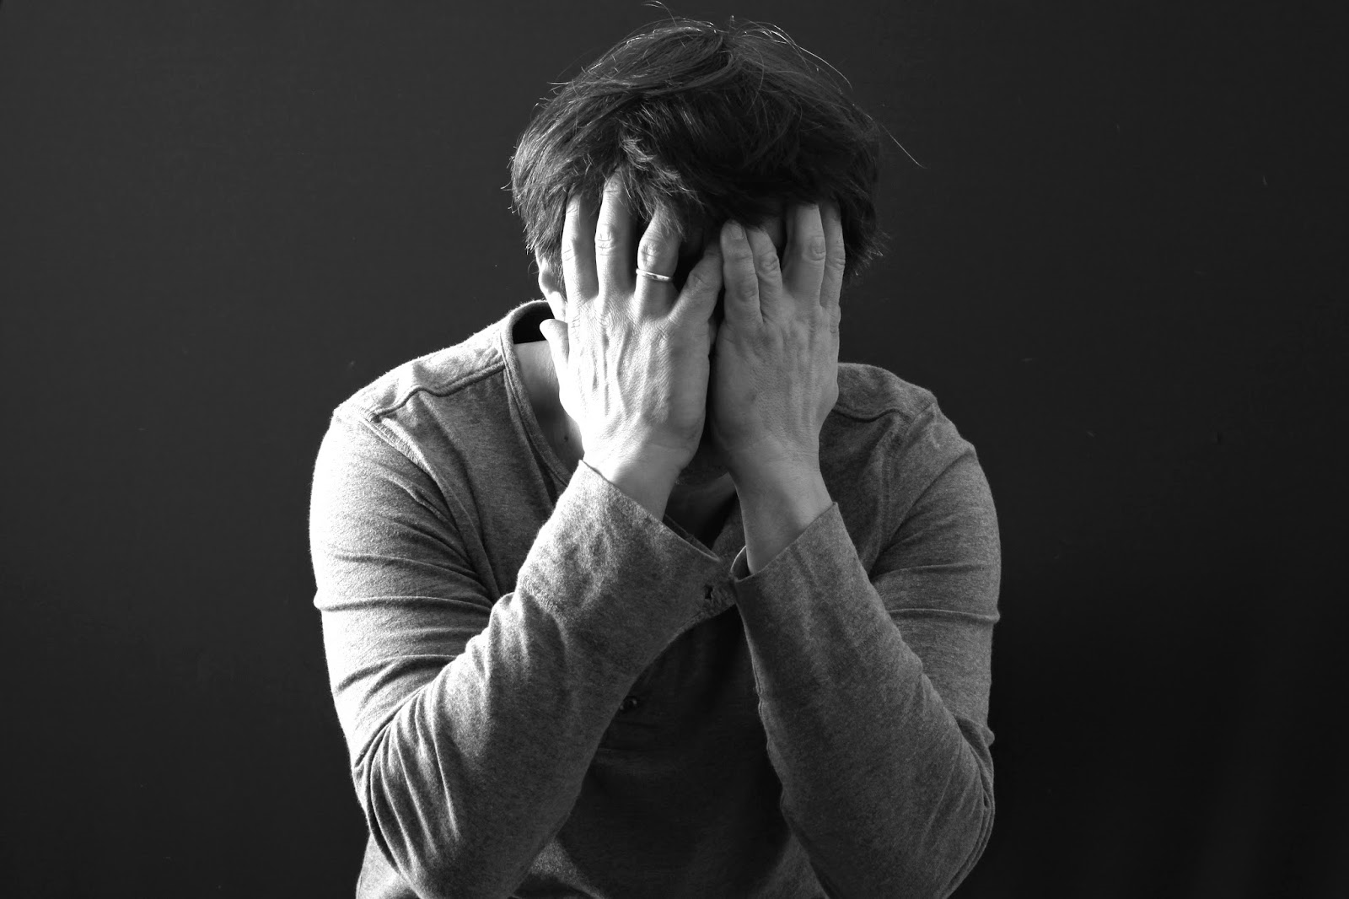
How does the work of God get done?
1. Weeping (v4)
Notes:
‘How does the work of God get done?’ This is a key question. The passage gives us important answers.
It’s not strictly true that the first thing he does is pray.
v4 ‘When I heard these things, I sat down and wept.’
Weep over the state of the church in the UK. When did we last weep that our own church, our own community, is not all it could be under God. Easy to smooth out. ‘Concern’. But v4 says ‘weep’.
Reflects something deep in the heart of God. John 17. Jesus wept.
William Booth, SA. Tough district. Tough city. Broken walls. All our plans have fallen through, it’s just not working. ‘Try tears’.
Broken heart. Tears.
We are deeply moved at our own concerns. Do we weep because in church and in wider society the wall is broken.

Slide 6
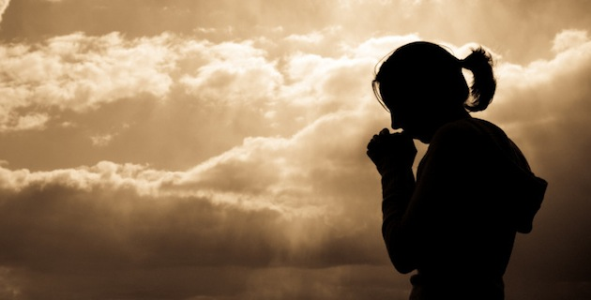
Praying vv4-11
Notes:
Then turns to prayer.
Remember the question, ‘How does the work of God get done?’
Notice the order, weeping, praying…
Not plan of action, then prayer; not even weeping then plan of action. Weeping, prayer, then action (which is covered by prayer)
Our first thought is do something. We plan and strategize. Nehemiah’s first thoughts are weeping and prayer.
There is much action and very clear strategies and leadership as the book unfolds. That is not the place to start.

Slide 7
Praying
10 May - 20 May
Prayer room
Friday / Saturday night of prayer (11-12)
Ascension Day worship (10)
Notes:
Our prayer week soon after I arrived.
A new one w/c 13 May. Encourage you to commit.
Thy Kingdom Come is a global initiative. Begun by the Archbishops of Canterbury and York. Now global and interchurch.
We’ll be using their resources for prayer stations etc.

Slide 8
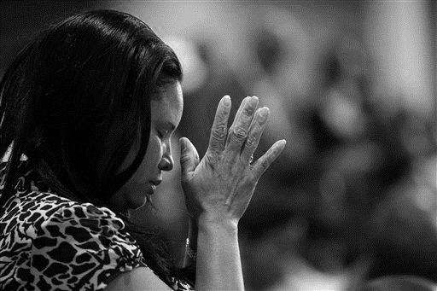
Only God can do it (v5)
Confession (vv6-7)
‘Pleading God’s promises’ (vv8-9)
Waiting for the answer (1.1 cf. 2.1)
Notes:
Only God can do it (v5 v11)
Putting your faith in God in this impossible situation.
Wallace Benn story of a bike. I really want that. If I mortgage my pocket money, by the time I’ve got enough to buy the bike I’ll be too old to enjoy it. The only way this will work is if you just buy it for me.
The only way anything’s going to happen is if God does this.
It’s even worse than this passage on its own suggests.
Ezra 4. The wall building was stopped by Artaxerxes. It’s Artaxerxes again. He’s going to be going to the same King who stopped it before.
But God is sovereign and the King is only a man.
Confession (vv6-7)
He puts himself with the people.
We confess our cold heartedness, our half-heartedness, we stand together.
‘Pleading God’s promises’ (vv8-9)
God seems to love it when we do this.
The Scriptures are full of such prayers.
Know God’s will and pray it. We know God’s will through the Scriptures.
Waiting for the answer (1.1 cf. 2.1)
There is at least a four month gap. Kislev and Nisan.
Why? It’s a big question. Unanswered prayer. We don’t have all the answers this side of heaven. Sometimes we ask for the wrong things, sometimes the answers no. But here the answer is yes. Nehemiah is God’s man. Why this time delay?
God wants to do something not only through Nehemiah, but in Nehemiah.
God wants to do something through us. God wants to do something in us.
God truly uses prayer to change things. But he also wants to change us.

Slide 9
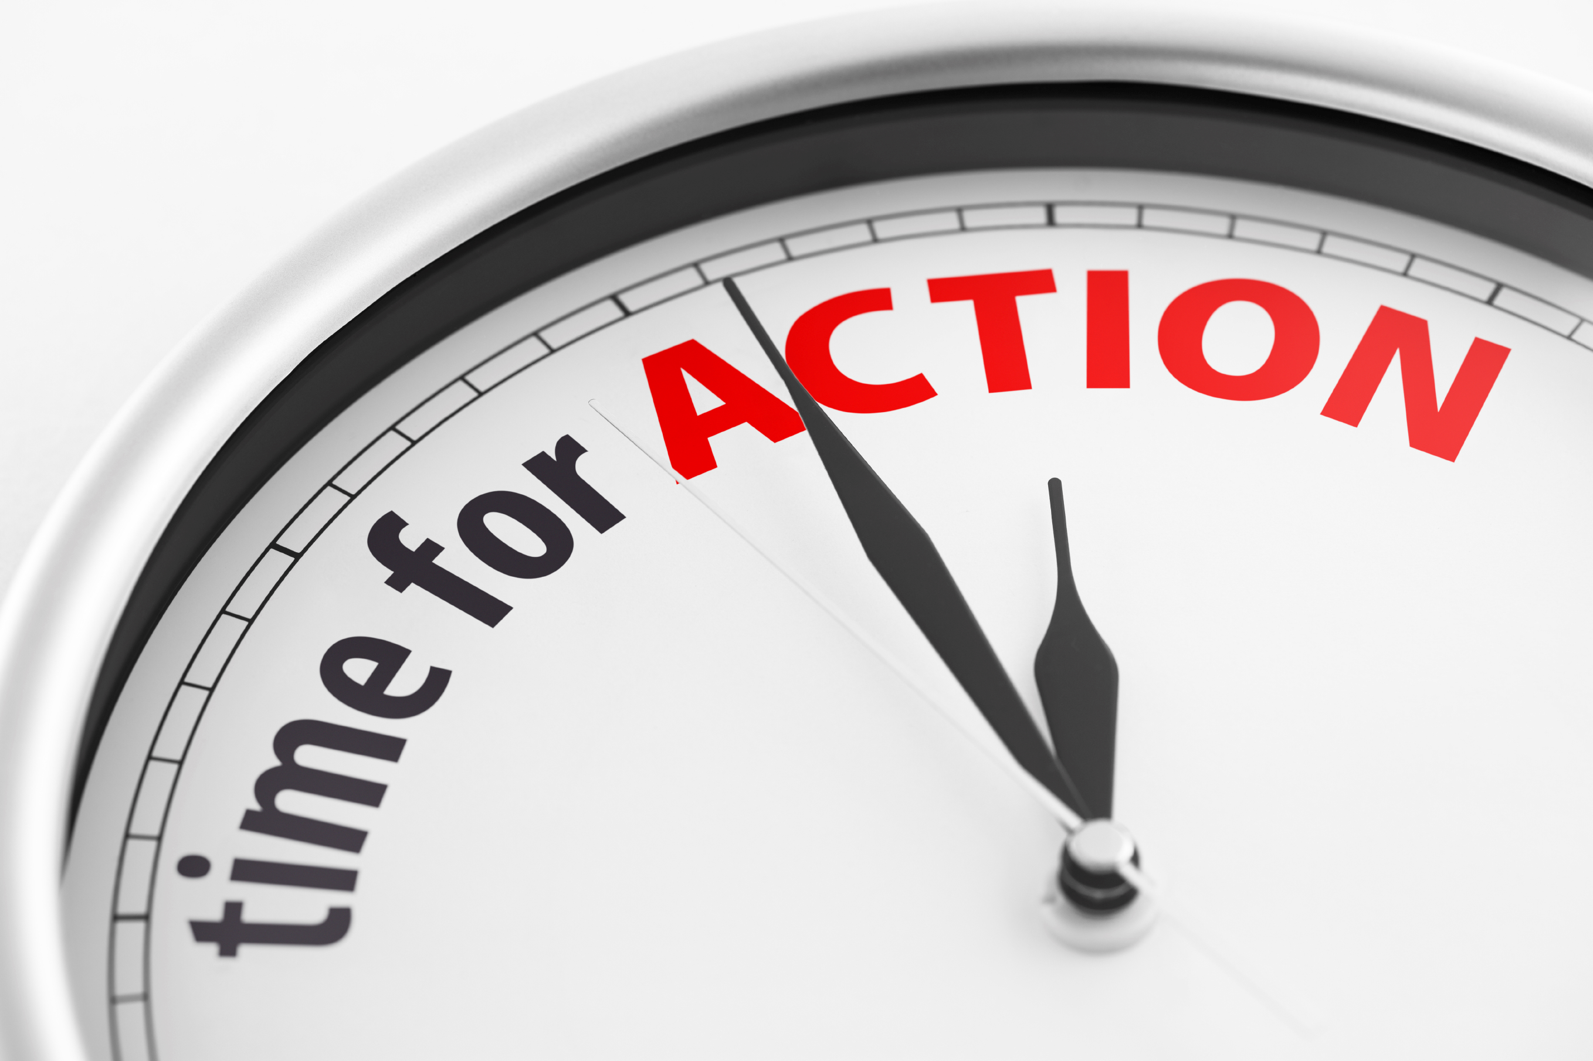
Acting (v11)
Notes:
Prayer is dangerous.
Nehemiah recognised that God wanted him to be the answer. God was going to use him.
Broken wall. 0.85%. God calls us to pray. God calls us to act.

