Slide 1
Good News for the Grieving
Luke 8 v 40-56

Slide 2
1. We live in a broken world

Slide 3
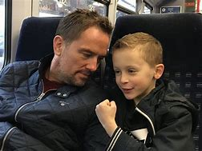
Simon Thomas:
“Actually to try and be strong in this moment is a leap from reality…”
"All I can do at the moment is unclinch those fists, stop trying to be strong, and say to people, no - this is me, and this is what grief looks like."

Slide 4
1. We live in a broken world

Slide 5
2. Jesus brings hope and restoration

Slide 6
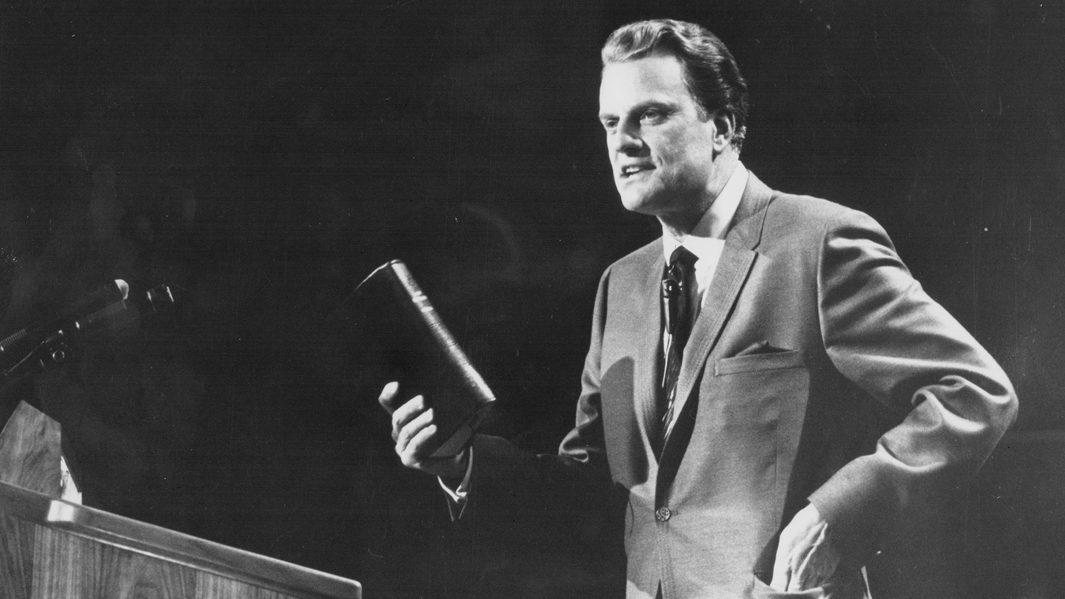
Billy Graham:
"Someday you will read or hear that Billy Graham is dead. Don’t you believe a word of it. I shall be more alive than I am now. I will just have changed my address. I will have gone into the presence of God."

